Slide 1
State of Georgia Social Media Guide
Social Media Content for 2020 Census
September 2020

Slide 2
Social Media Messaging Calendar
Day by Day topics to post

Slide 3
SEPTEMBER 2020- FINAL PUSH
SUNDAY | MONDAY | TUESDAY | WEDNESDAY | THURSDAY | FRIDAY | SATURDAY
 |  |  | 9/16 | 9/17 | 9/18 | 9/19
9/20 | 9/21 | 9/22 | 9/23 | 9/24 | 9/25 | 9/26
9/27 | 9/28 | 9/29 | 9/30
Georgia Ranks 47th in Census Respose
The 2020 Census Affects You!
Sound the Alarm!
Your Census Response is Safe
Your Census Response Matters
Georgia Could Lose Billions
Time Is Running Out
The Census Affects Business Decisions
Time is Running Out for Georgia
YOUR Future is Calling
Engaging with a Census Taker is Safe
A lot of Money is at Stake
Your Responses Matter
Confidentiality
Georgia, Today is the Last Day
Post Content

Slide 4
Social Media Content
All assets on slides 5-20 are organized chronologically

Slide 5

Georgia ranks 47th in Total Census Response 9/16
Suggested Platform: FACEBOOK/NEXTDOOR/EMAIL
Suggested copy:
Hello, fellow [City/County/Georgia] residents! Georgia is in a state of emergency with regard to the 2020 Census. There are a number of households in Georgia that have yet to participate in the 2020 Census.
Billions of dollars are on the line and [City/County/Georgia] stands to lose our fair share for education, healthcare, roads and so much more if residents in our community don’t participate. We are even at risk of losing a congressional seat, which could weaken our voice in Congress over the next 10 years.
If you haven’t completed the 2020 Census yet, please take just 10 minutes of your day right now and go to www.my2020census.gov and be counted. It’s safe, easy and important.
Regards,
[Name]
Suggested Platform Line: INSTAGRAM/TWITTER
Georgia is falling behind in the 2020 census count. Billions of dollars are on the line and [City/County/Georgia] stands to lose our fair share for education, healthcare, roads, and so much more if residents in our community don’t participate. Respond today at www.my2020census.gov or by calling 1-844-330-2020. #2020Census #GAcounts

Slide 6

The 2020 Census Affects You! 9/17
Suggested Platform: FACEBOOK/NEXTDOOR/EMAIL
Suggested copy:
Good day, neighbors! Did you know that the 2020 Census has a direct impact on your quality of life in [City/County/Georgia]?
So many services that you use everyday are affected by the 2020 Census count. The roads you drive on, the school your child attends, and emergency response services for your community will all receive federal funding based upon the 2020 Census count. That means if people like you don’t complete the census, our community will not receive it’s fair share of funding for the services you need.
Our area currently has a low response rate so we’re at risk of losing millions of dollars for the next decade. You can participate by cooperating with a census taker when he/she knocks on your door or by self-responding online, by phone or by mail.
Have a great day!
[Name]
Suggested Platform Line: INSTAGRAM/TWITTER
The roads you drive on, the school your child attends, and emergency response services for your community will all receive federal funding based upon the 2020 Census count. If you aren’t counted, our community won’t receive adequate funding for these programs. Quickly respond today at my2020census.gov or by phone at 1-844-330-2020. #2020Census #GAcounts

Slide 7

Sound the Alarm! 9/18
Suggested Platform: FACEBOOK/NEXTDOOR/EMAIL
Suggested copy:
[City/County/Georgia] ranks towards the bottom in 2020 Census response and we stand to lose money and power for the next 10 years if you and your household don’t participate.
If you care about more funding for our local schools, Medicaid, pell grants for students to go to college, and food assistance programs, then you and everyone you know needs to be counted in the 2020 Census. These and hundreds of other programs are funded based upon the Census count. If you’re not counted then, your community can lose thousands of dollars in funding for the programs you use every day.
If you haven’t completed the 2020 Census, you may receive a visit from a census taker and it’s safe to cooperate. They are obligated by law to keep your responses strictly confidential. You also have the option of responding online, by phone or by mail. Sound the alarm and tell everyone you know to complete the Census today! Respond TODAY at www.my2020census.gov.
Regards,
[Name]
Suggested Platform Line: INSTAGRAM/TWITTER
If you care about more funding for our local schools, Medicaid, pell grants for students to go to college, and food assistance programs, then you and everyone you know needs to be counted in the 2020 Census. These and hundreds of other programs are funded based upon the Census count. Respond today at www.my2020census.gov or call 1-844-330-2020. #2020Census #GAcounts

Slide 8
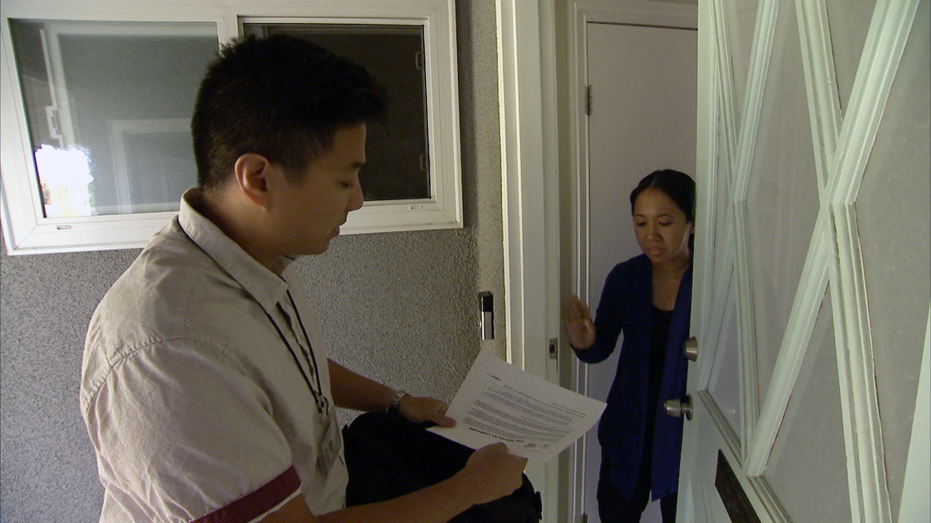
Your Census Response is Safe! 9/19
Suggested Platform: FACEBOOK/NEXTDOOR/EMAIL
Suggested copy:
Hi, neighbors! Census takers are knocking on doors of households that have not yet responded to the 2020 Census. Why? Because [City/County/Georgia] desperately needs your response to receive funding for services we use everyday.
Don’t buy into any of the conspiracy theories that the government is trying to get your personal information. Census takers will never ask for your social security number, money or donations, anything on behalf of a political party, nor your bank or credit card account numbers. Additionally, there is no citizenship question on the 2020 Census.
It’s safe to cooperate with a census taker, as they are obligated by law to keep your response completely confidential. Your response is critical to our community receiving it’s fair share of federal funding. Respond TODAY at www.my2020census.gov.
Best regards,
[Name]
Suggested Platform Line: INSTAGRAM/TWITTER
[City/County/Georgia] needs you to complete the 2020 Census. Census takers will never ask for financial information, social security number or citizenship status. Cooperate with a census taker or self-respond online at www.my2020census.gov
#2020Census #GAcounts

Slide 9
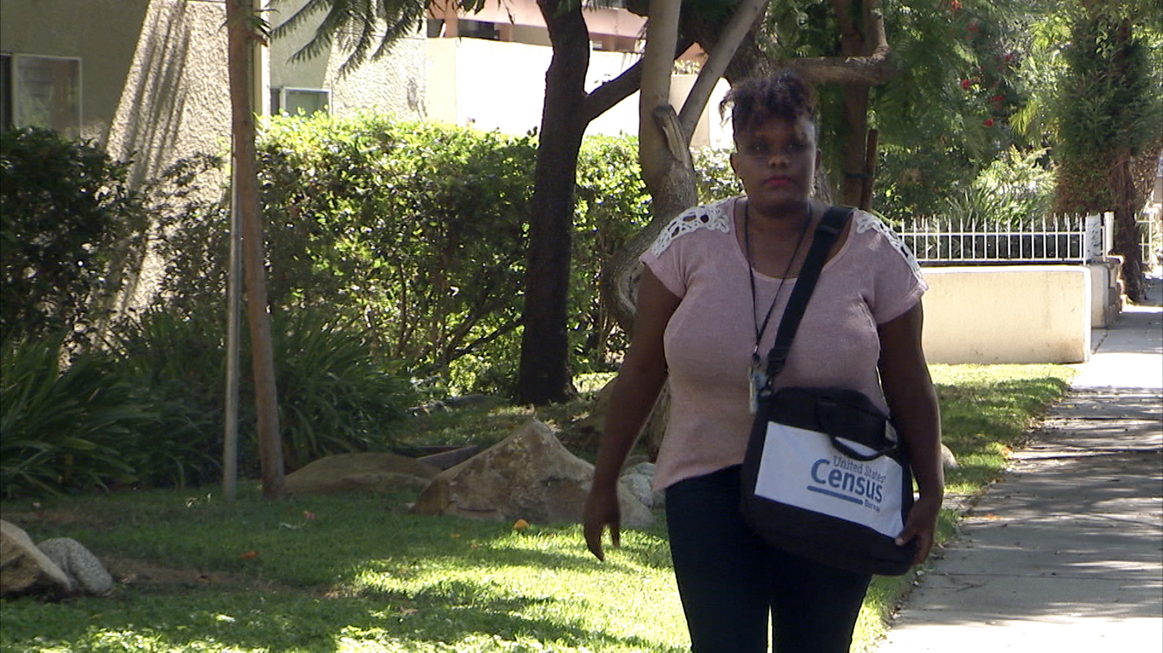
Your Census Response Matters More Than You May Know 9/20
Suggested Platform: FACEBOOK/NEXTDOOR/EMAIL
Suggested copy:
Hello, [City/County/Georgia] neighbors! If you think the 2020 Census doesn’t have an affect on you, then you’re sadly mistaken.
Do you have a child in Headstart or who receives school lunch assistance? Do you use public transportation or have potholes in your community? Do you receive housing assistance? Do receive federal loans or pell grants for college? If so, then the 2020 Census directly impacts you!
That’s why we need you to fill it out so our community can get it’s fair share of funding for all of these programs. Our community currently has a low response and stands to lose millions every year for the next decade.
Please cooperate with the census taker when he/she knocks on your door. You can also quickly self-respond today at www.my2020census.gov or by calling 1-844-330-2020. The next 10 years will be shaped by your response.
Regards,
[Name]
Suggested Platform Line: INSTAGRAM/TWITTER
Do you have a child in Headstart or who receives school lunch assistance? Do you use public transportation or have potholes in your community? Do you receive housing assistance? Do receive federal loans or pell grants for college? If so, then the 2020 Census directly impacts you!
Cooperate with a census taker or respond online at www.my2020census.gov to complete the census. #2020Census #GAcounts

Slide 10
Georgia Could Lose Millions 9/21
Suggested Platform: FACEBOOK/NEXTDOOR/EMAIL
Suggested copy:
Did you know Georgia is at risk of losing millions of dollars over the next ten years? If we don't act now, we could lose desperately needed funding for vital programs such as Medicare, food assistance programs, children’s healthcare and so much more.
So, ACT NOW and respond to the 2020 Census online at www.my2020census.gov or by calling 1-844-330-2020.
It's safe, it's fast and it's important.
Suggested Platform Line: INSTAGRAM/TWITTER
Did you know Georgia is at risk of losing millions of dollars over the next ten years? If we don't act now, we could lose desperately needed funding for vital programs such as Medicare, food assistance programs, children’s healthcare and so much more.
Respond today at www.my2020census.gov or call 1-844-330-2020. #2020Census #GAcounts
To save video, right-click and select “save media as.”

Slide 11

Time is Running out 9/22
Suggested Platform: FACEBOOK/NEXTDOOR/EMAIL
Suggested copy:
TIME IS RUNNING OUT to respond the 2020 Census. [City/County/Georgia] could lose hundreds of millions of dollars for the next ten years.
Funding the will critically impact services our community needs. Services like; Medicare, transportation, housing, health insurance, food assistance programs and so much more.
So, if a census taker knocks on your door, please cooperate. Your responses are protected by law and cannot be shared. You can also Act Now and respond to the 2020 Census by calling 1-844-330-2020 or go online to my2020census.gov
Remember, responding to the 2020 Census is safe, easy and important.
https://www.youtube.com/watch?v=NyFZ6TWBXdE
Suggested Platform Line: INSTAGRAM/TWITTER
Time is running out, but it’s not too late to respond to the 2020 Census. The census will be used to determine the amount of funding [City/County/Georgia] receives for services such as Medicaid, public transportation, food assistance programs and more. We need you to respond now at www.my2020census.gov or by phone at 1-844-330-2020. #2020Census #GAcounts
To play video, double-click. To save video, right-click and select “save media as.”

Slide 12
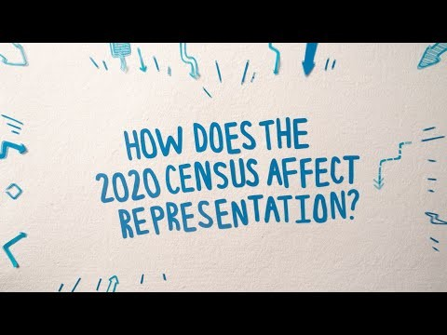
The Census Affects Business Decisions 9/23
Suggested Platform: FACEBOOK/NEXTDOOR/EMAIL
Suggested copy:
Whatever your community is lacking, your response to the 2020 Census can help.
Do you have to drive across town to get to a hospital? Do you have to leave your community to shop at the grocery store? Could your neighborhood benefit from more job opportunities?
By being counted in the 2020 Census, you will help inform businesses as it pertains to where they should invest. If you’re not counted, businesses won’t see the benefit of pouring resources into your community.
ACT NOW and complete the 2020 Census by cooperating with a census taker or by self-responding online, by phone, or by mail. Visit www.my2020census.gov to respond TODAY.
[Name]
Suggested Platform Line: INSTAGRAM/TWITTER
Do you have to drive across town to get to a hospital? Do you have to leave your community to shop at the grocery store? Could your neighborhood benefit from more job opportunities?
By being counted in the 2020 Census, you will help inform businesses as it pertains to where they should invest. Respond now at www.my2020census.gov or by calling 1-844-330-2020.
#2020Census #GAcounts
To save video, right-click and select “save media as.” Note: This video has audio.

Slide 13
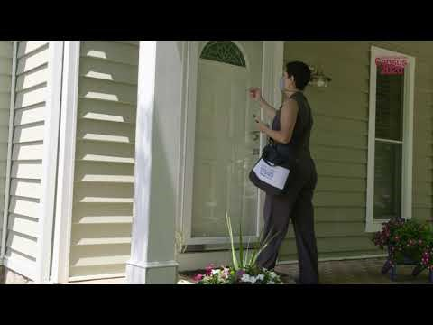
Time is Running Out for GA 9/24
Suggested Platform: FACEBOOK/NEXTDOOR/EMAIL
Suggested copy:
With only two weeks left to respond, Georgia is ranked 47th in the country, which puts us at risk of losing millions in federal funding over the next 10 years!
However, it’s not too late to help make a difference in your community. Respond online now at www.my2020census.gov or call 1-844-330-2020 to respond by phone.
If a census taker comes to your home, please cooperate. Your community needs your response. Census takers are trained to rigorously follow CDC recommendations to reduce the risk of transmission by wearing face masks, maintaining social distance of 6 feet or more, practicing hand hygiene, and conducting interviews outside as much as possible.
You can minimize the need for a census taker visit by responding TODAY, and please remind your friends, family, and neighbors to do the same.
https://www.youtube.com/watch?v=QuyfxxzHyuI&t=41s
Suggested Platform Line: INSTAGRAM/TWITTER
With only two weeks left to respond, Georgia is ranked 47th in the country, which puts us at risk of losing millions in federal funding over the next 10 years!
However, it’s not too late to help make a difference in your community. Respond online now at www.my2020census.gov or call 1-844-330-2020 to respond by phone. #2020Census #GAcounts
To save video, right-click and select “save media as.” Note: This video has audio.

Slide 14
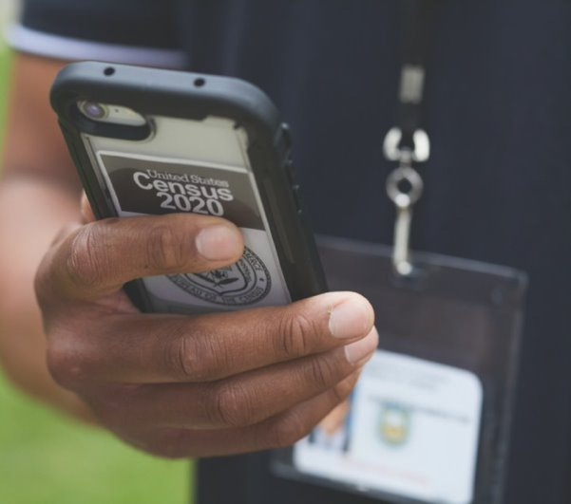
YOUR Future is Calling 9/25
Suggested Platform: FACEBOOK/NEXTDOOR/EMAIL
Suggested copy:
Census takers are visiting homes and reaching out over the phone to make sure everyone is counted in the 2020 Census. It is your last chance to make a difference in informing how hundreds of billions of dollars are spent every year on health care, education, roads, and much more for the next 10 years. Respond now at www.my2020census.gov instead of waiting for a census taker to call or knock on your door.
If a census taker visits you, please cooperate. Answering the census taker’s questions is easy, safe and important.
Ensure your voice is heard for your family, for your community, for the future. Respond Today!
Suggested Platform Line: INSTAGRAM/TWITTER
Census takers are visiting homes and reaching out over the phone to make sure everyone is counted in the 2020 Census. It is your last chance to make a difference securing federal funding for our community every year on health care, education, roads and much more for the next 10 years. Respond now at www.my2020census.gov instead of waiting for a census taker to call or knock on your door. #2020Census #GAcounts
To save video, right-click and select “save media as.” Note: This video has audio.

Slide 15
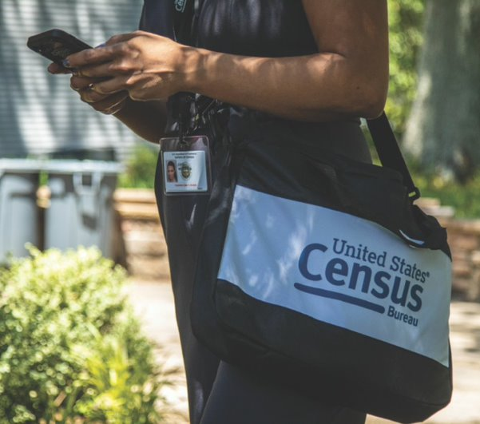
Engaging with a Census Taker is Safe 9/26
Suggested Platform: FACEBOOK/NEXTDOOR/EMAIL
Suggested copy:
The U.S. Census Bureau is taking every precaution necessary and working closely with the CDC to ensure everyone’s safety. ​Census takers are trained to rigorously follow CDC recommendations to reduce the risk of transmission, including:​
Census takers will wear masks and follow public health guidelines when they visit. ​
Census takers will maintain social distance of 6 feet or more, will not enter homes, and will conduct interviews outside as much as possible or practical.​
Census takers take an oath to keep individual responses strictly confidential.​
The Census Bureau does not share your information with ICE or any law enforcement agency. Your information is safe and secure.
It’s never been easier to respond to the 2020 Census, without ever needing to meet a census taker. Visit www.My2020Census.gov or call 1-844-330-2020 to respond TODAY!
Suggested Platform Line: INSTAGRAM/TWITTER
The U.S. Census Bureau is taking every precaution necessary and working closely with the CDC to ensure everyone’s safety. ​Census takers are trained to rigorously follow CDC recommendations to reduce the risk of transmission. It’s safe to cooperate with a census taker and our community needs your response. #2020Census #GAcounts
To play video, double-click. To save video, right-click and select “save media as.”

Slide 16
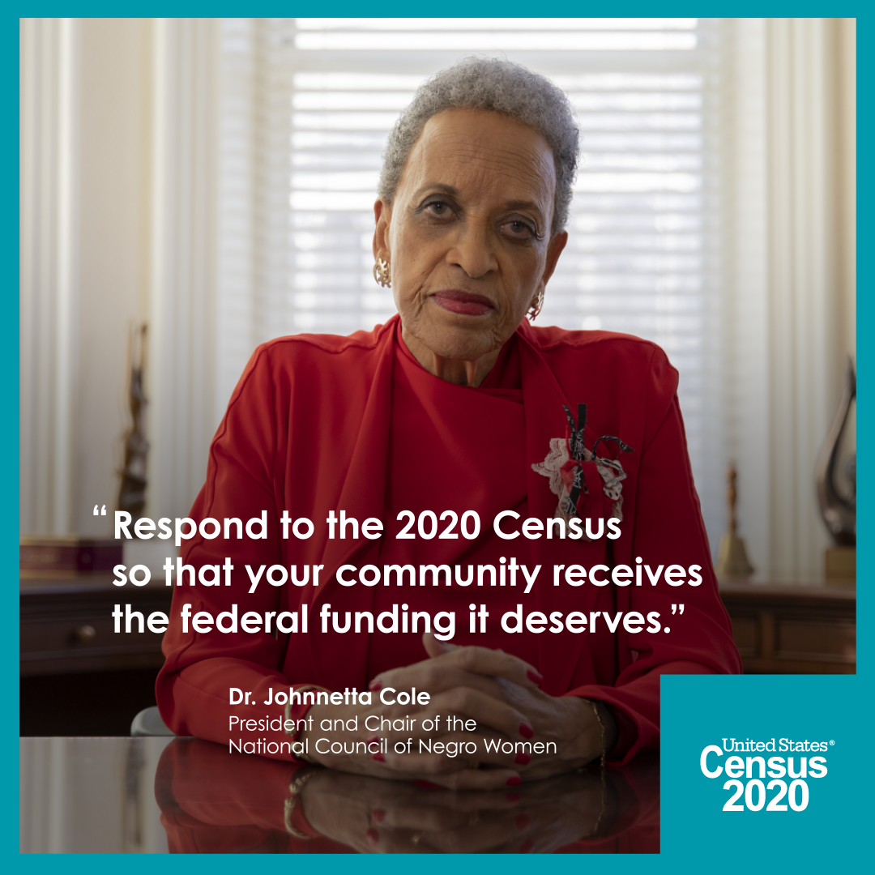
A lot of Money is at Stake 9/27
Suggested Platform: FACEBOOK/NEXTDOOR/EMAIL
Suggested copy:
Time is running out on the 2020 Census, and currently Georgia is trailing behind at 47th in the country.
Don’t miss out on the funding we deserve! Respond now while there’s still time at www.my2020census.gov or by calling 1-844-330-2020.
To ensure everyone in Georgia is counted, Census takers are currently knocking on doors and calling by phone to collect responses from households that have not self-responded.
Cooperating with a census taker is safe and will help our community secure federal funds for Medicare, children’s health insurance, food assistance programs, roads and education, and so much more.
Suggested Platform Line: INSTAGRAM/TWITTER
Time is running out on the 2020 Census, and currently Georgia is trailing behind at 47th in the country.
Don’t miss out on the funding we deserve! Respond now while there’s still time at www.my2020census.gov or by calling 1-844-330-2020. #2020Census #GAcounts
To save video, right-click and select “save media as.” Note: This video has audio.

Slide 17
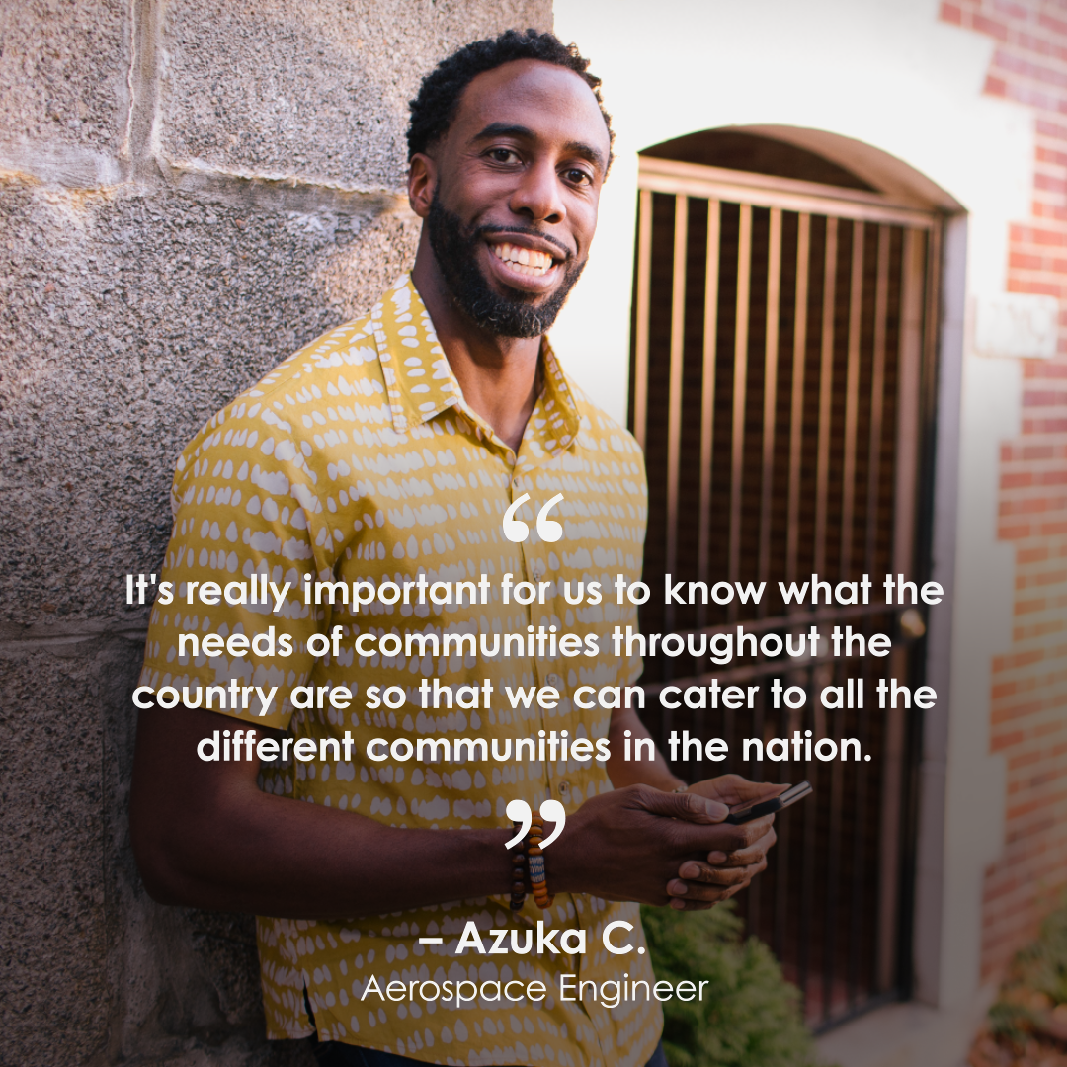
Your Responses Matter 9/28
Suggested Platform: FACEBOOK/NEXTDOOR/EMAIL
Suggested copy:
Georgia, time is running out to get the resources we deserve. Respond to the 2020 Census TODAY while there’s still time and make your voice heard.
Visit www.my2020census.gov to respond online or call 1-844-330-2020 to respond by phone.
To ensure everyone in Georgia is counted, Census takers are still knocking on doors and calling by phone to collect responses from households that have not self-responded.
Cooperating with a census taker is safe and will help our community secure federal funds for Medicare, children’s health insurance, food assistance programs, roads and education, and so much more.
Suggested Platform Line: INSTAGRAM/TWITTER
Georgia, time is running out to get the resources we deserve. Respond to the 2020 Census TODAY while there’s still time and make your voice heard.
Visit www.my2020census.gov to respond online or call 1-844-330-2020 to respond by phone.
#2020Census #GAcounts
To save video, right-click and select “save media as.” Note: This video has audio.

Slide 18
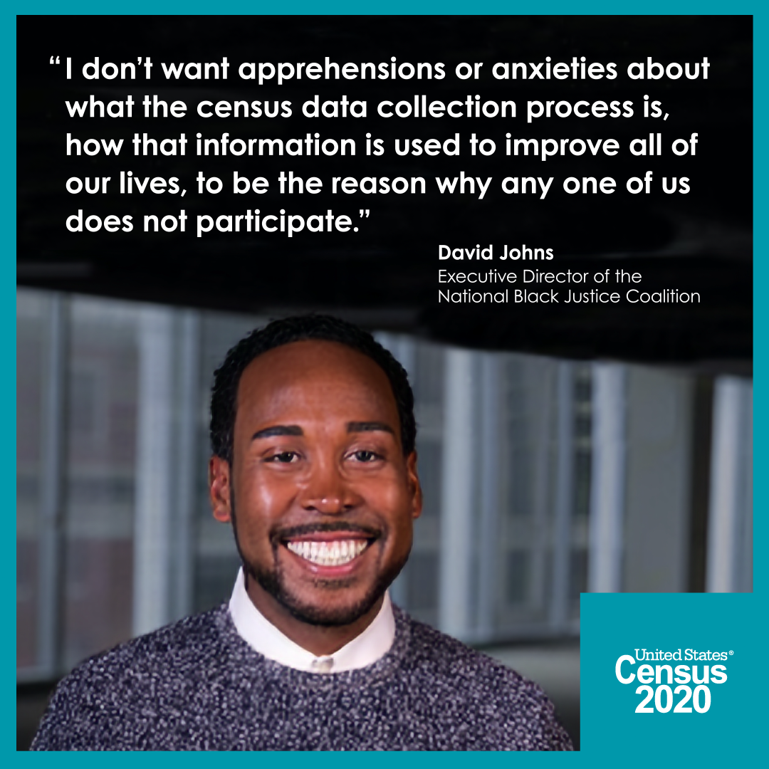
Confidentiality 9/29
Suggested Platform: FACEBOOK/NEXTDOOR/EMAIL
Suggested copy:
We’re down to the wire and we need you to be counted in the 2020 Census. Your responses to the #2020Census are confidential and protected by law. Complete the census now before time runs out.
Visit www.my2020census.gov to respond online or call 1-844-330-2020 to respond by phone.
To ensure everyone in Georgia is counted, Census takers are still knocking on doors today and calling by phone to collect responses from households that have not self-responded.
Cooperating with a census taker is safe and will help our community secure federal funds for Medicare, children’s health insurance, food assistance programs, roads and education, and so much more.
Suggested Platform Line: INSTAGRAM/TWITTER
We’re down to the wire and we need you to be counted in the 2020 Census. Your responses to the #2020Census are confidential and protected by law. Complete the census now before time runs out.
Visit www.my2020census.gov to respond online or call 1-844-330-2020 to respond by phone. #2020Census #GAcounts
To play video, double-click. To save video, right-click and select “save media as.”

Slide 19
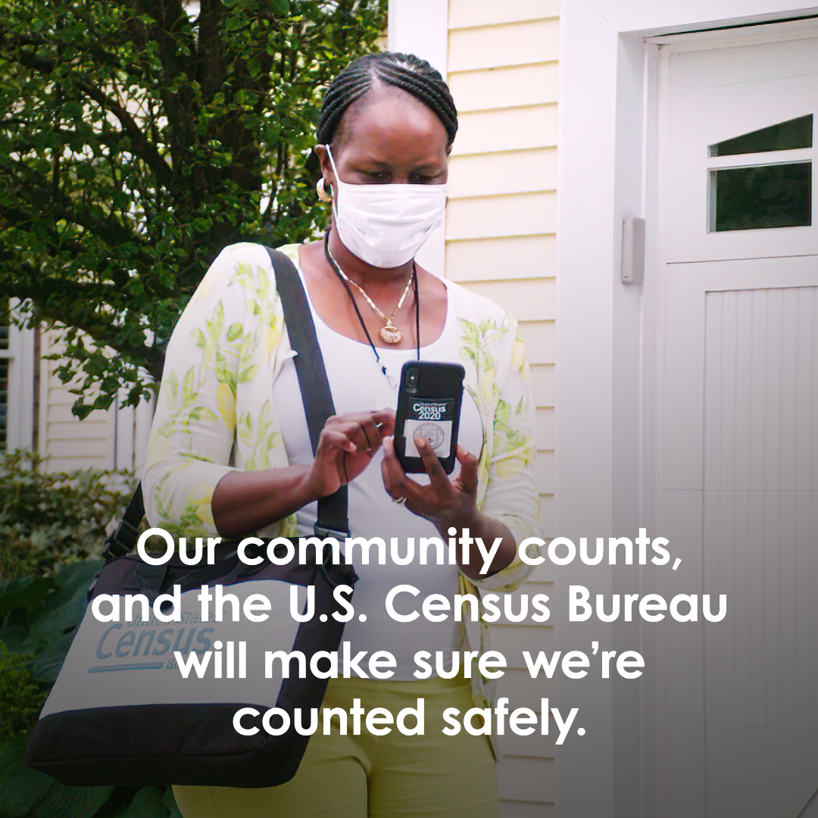
Georgia, Today is the LAST DAY 9/30
Suggested Platform: FACEBOOK/NEXTDOOR/EMAIL
Suggested copy:
Georgia, today is the last day to self-respond to the 2020 Census and get the resources we need! Please complete the 2020 Census TODAY at www.my2020census.gov or by calling 1-844-330-2020 to respond by phone.
To ensure everyone in Georgia is counted, Census takers are currently knocking on doors and calling by phone to collect responses from households that have not self-responded.
The Census Bureau is taking every precaution to make sure the community is counted safely, including wearing masks and keeping a safe distance.
Cooperating with a census taker is safe and will help our community secure federal funds for Medicare, children’s health insurance, food assistance programs, roads and education, and so much more.
Suggested Platform Line: INSTAGRAM/TWITTER
Georgia, today is the last day to self-respond to the 2020 Census and get the resources we need! Please complete the 2020 Census TODAY at www.my2020census.gov or by calling 1-844-330-2020 to respond by phone. #2020Census #GAcounts
To save video, right-click and select “save media as.” Note: This video has audio.

