Slide 1
Mental Health: NACo and the Georgia Perspective
Savannah International Trade & Convention Center
April 29, 2023

Slide 2
Overview of Today’s Session
Welcome!
Introduction of Guest Panelists
Understanding Mental Health—What Are Our Objectives?
  To help county officials…
  1) Understand the issue and why counties need to be involved;
  2) Know how to get started and where to go for resources; and
  3) Identify best practices and strategies for action and implementation in their home communities.
Taking It Home: Applications for YOUR County
  Provide Access to Resources, Materials and Contacts to Get Started
Q&A/Wrap-Up

Slide 3
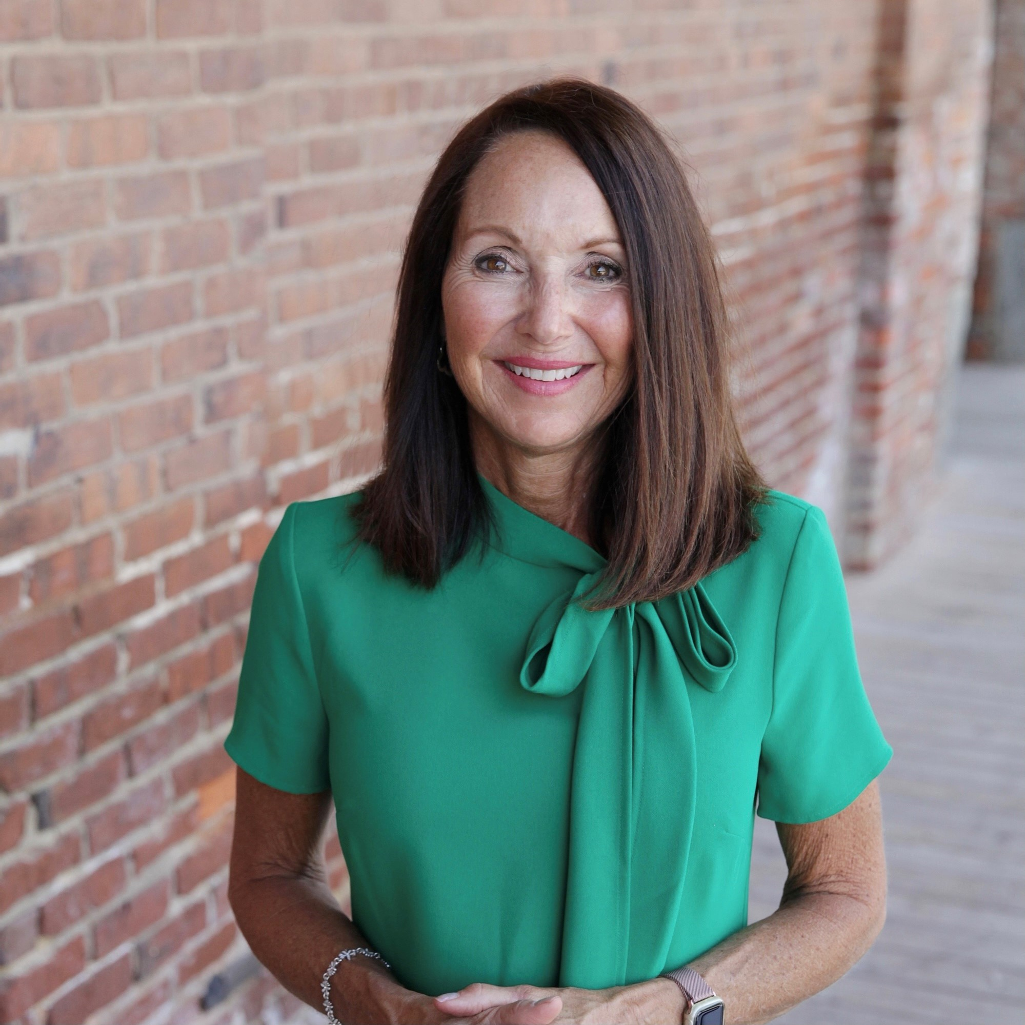
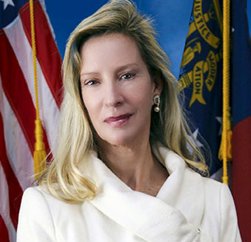
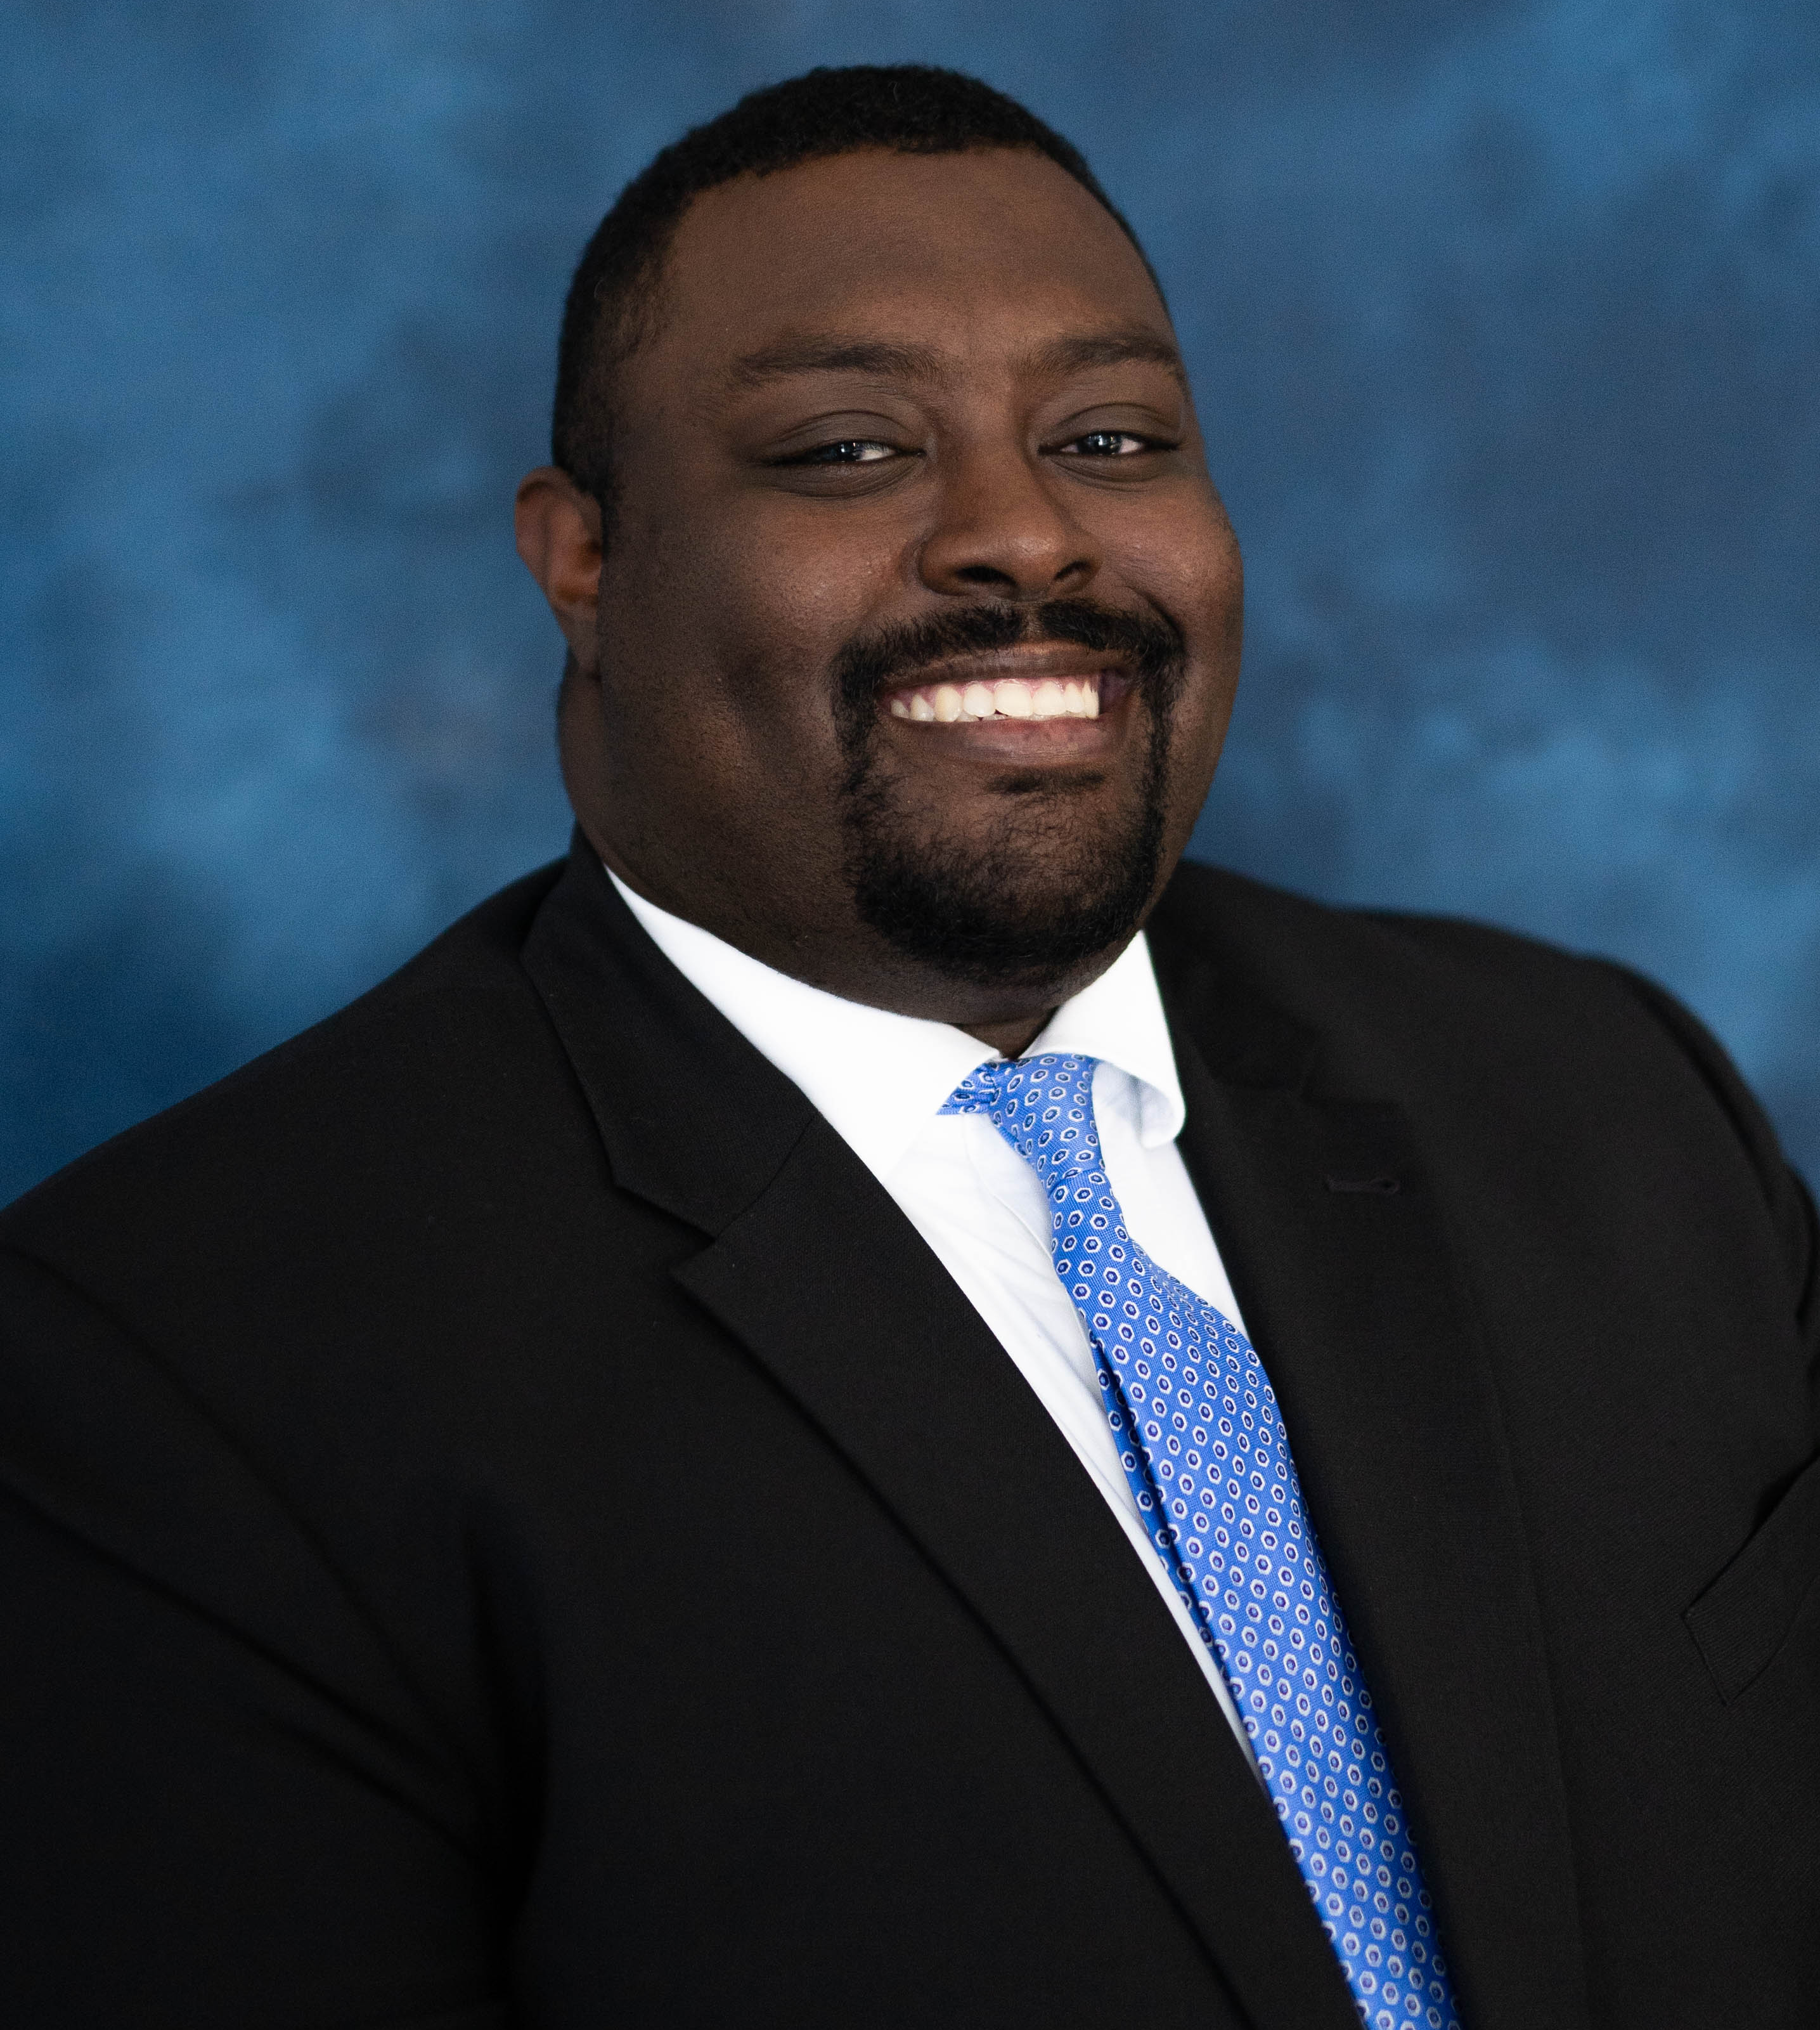
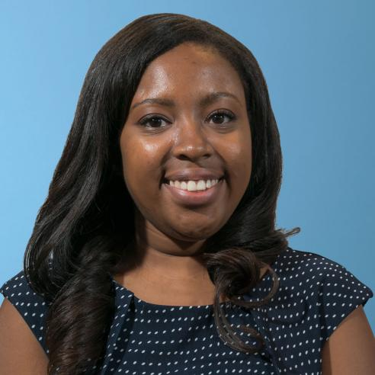
Guest Panelists
Blaire Bryant
Legislative Director for Health
NACo
Commissioner Helen Stone
Board of Commissioners
Chatham County
ACCG Board of Managers
NACo Representative
NACo Commission on Mental Health and Wellbeing
Member
Chairman Michelle Morgan
Board of Commissioners
Carroll County
ACCG Board of Managers
4th District
Gabe Carter
Governmental Affairs Associate
ACCG

Slide 4
NACo and the Commission on Mental Health & Wellbeing
Blaire Bryant
Legislative Director for Health

Slide 5
NACo: Commission on Mental Health & Wellbeing
Reimagining the Advancement of Mental Health Support for Americans
The Commission actively works to:
  Stimulate a national sense of urgency through an intergovernmental partnership framework connecting the local, state, and federal levels;
  Elevate national awareness around the challenges and the innovations associated with mental health through the county lens;
  Pursue federal policy action, including full implementation of the Mental Health Parity standard, reforms to the IMD prohibition, repealing the Medicaid Inmate Exclusion Policy for pre-trial detainees, and building the mental health workforce and continuum of care for the future; and
  Lead a cohesive, intergovernmental strategy to enhanced the mental health and wellbeing of all Americans, with a special focus on the most vulnerable populations.

Slide 6
NACo and the Commission on Mental Health & Wellbeing
Commissioner Helen Stone
Chatham County Board of Commissioners
NACo Board Member/Commission on Mental Health & Wellbeing

Slide 7
NACo Commission on Mental Health & Wellbeing
Stimulate
Stimulate national sense of urgency through an intergovernmental partnership framework
Elevate
Elevate the national awareness of the roles, innovations and pain-points
Achieve
Achieve NACo’s public policy agenda
Align
Align a cohesive national and intergovernmental strategy

Slide 8
ACCG Mental Health Legislative Overview
Gabe Carter
ACCG Governmental Affairs Associate

Slide 9
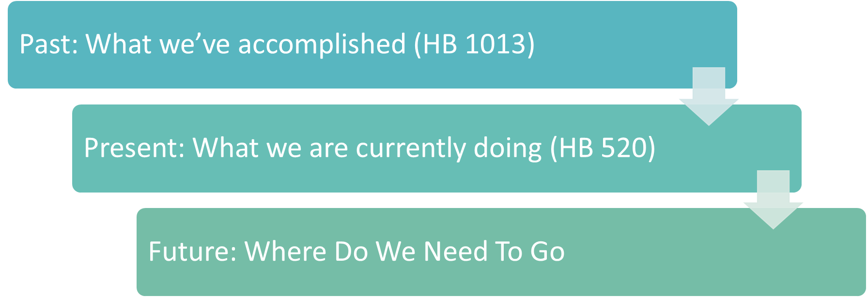
Presentation Outline

Slide 10
Looking Back, Progress Made…
Insurance Parity
Workforce Development
Assisted Outpatient Treatment
Mental Health Courts and Corrections
Data Sharing
What We’ve Accomplished – 2022
House Bill 1013

Slide 11
Where We Stand Today, Work Continues…
Criminal Justice and Behavioral Health
Addressing Homelessness and Supportive Housing
Workforce Development
What We Are Currently Doing – 2023
House Bill 520

Slide 12
Looking Ahead, Effort Continue…
Statewide Uniform Mental Health Evaluations in Local Jails
Expansion of Mental Health and Drug Courts
Expansion of Co-responder Units throughout Georgia
Increase Statewide Access to Psychologist and Psychiatrist
Increase the Number of Crisis Centers
Identify the Best System for Transporting Patients
Provide Adequate Supportive Housing Opportunities
Where We Need To Go

Slide 13
How YOU Can Help!
Partner with Behavioral Health Experts
Engage in ACCG’s Policy Development Process
Contact Your State Legislators

Slide 14
Learning From Your Peers: Georgia Counties Engage in Mental Health
Chairman Michelle Morgan
Carroll County Board of Commissioners
Commissioner Helen Stone
Chatham County Board of Commissioners

Slide 15
Carroll County: Mobile Crisis Team Units
https://vimeo.com/759908916

Slide 16

Chatham County: Behavioral Health Centers

Slide 17
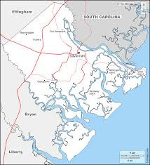
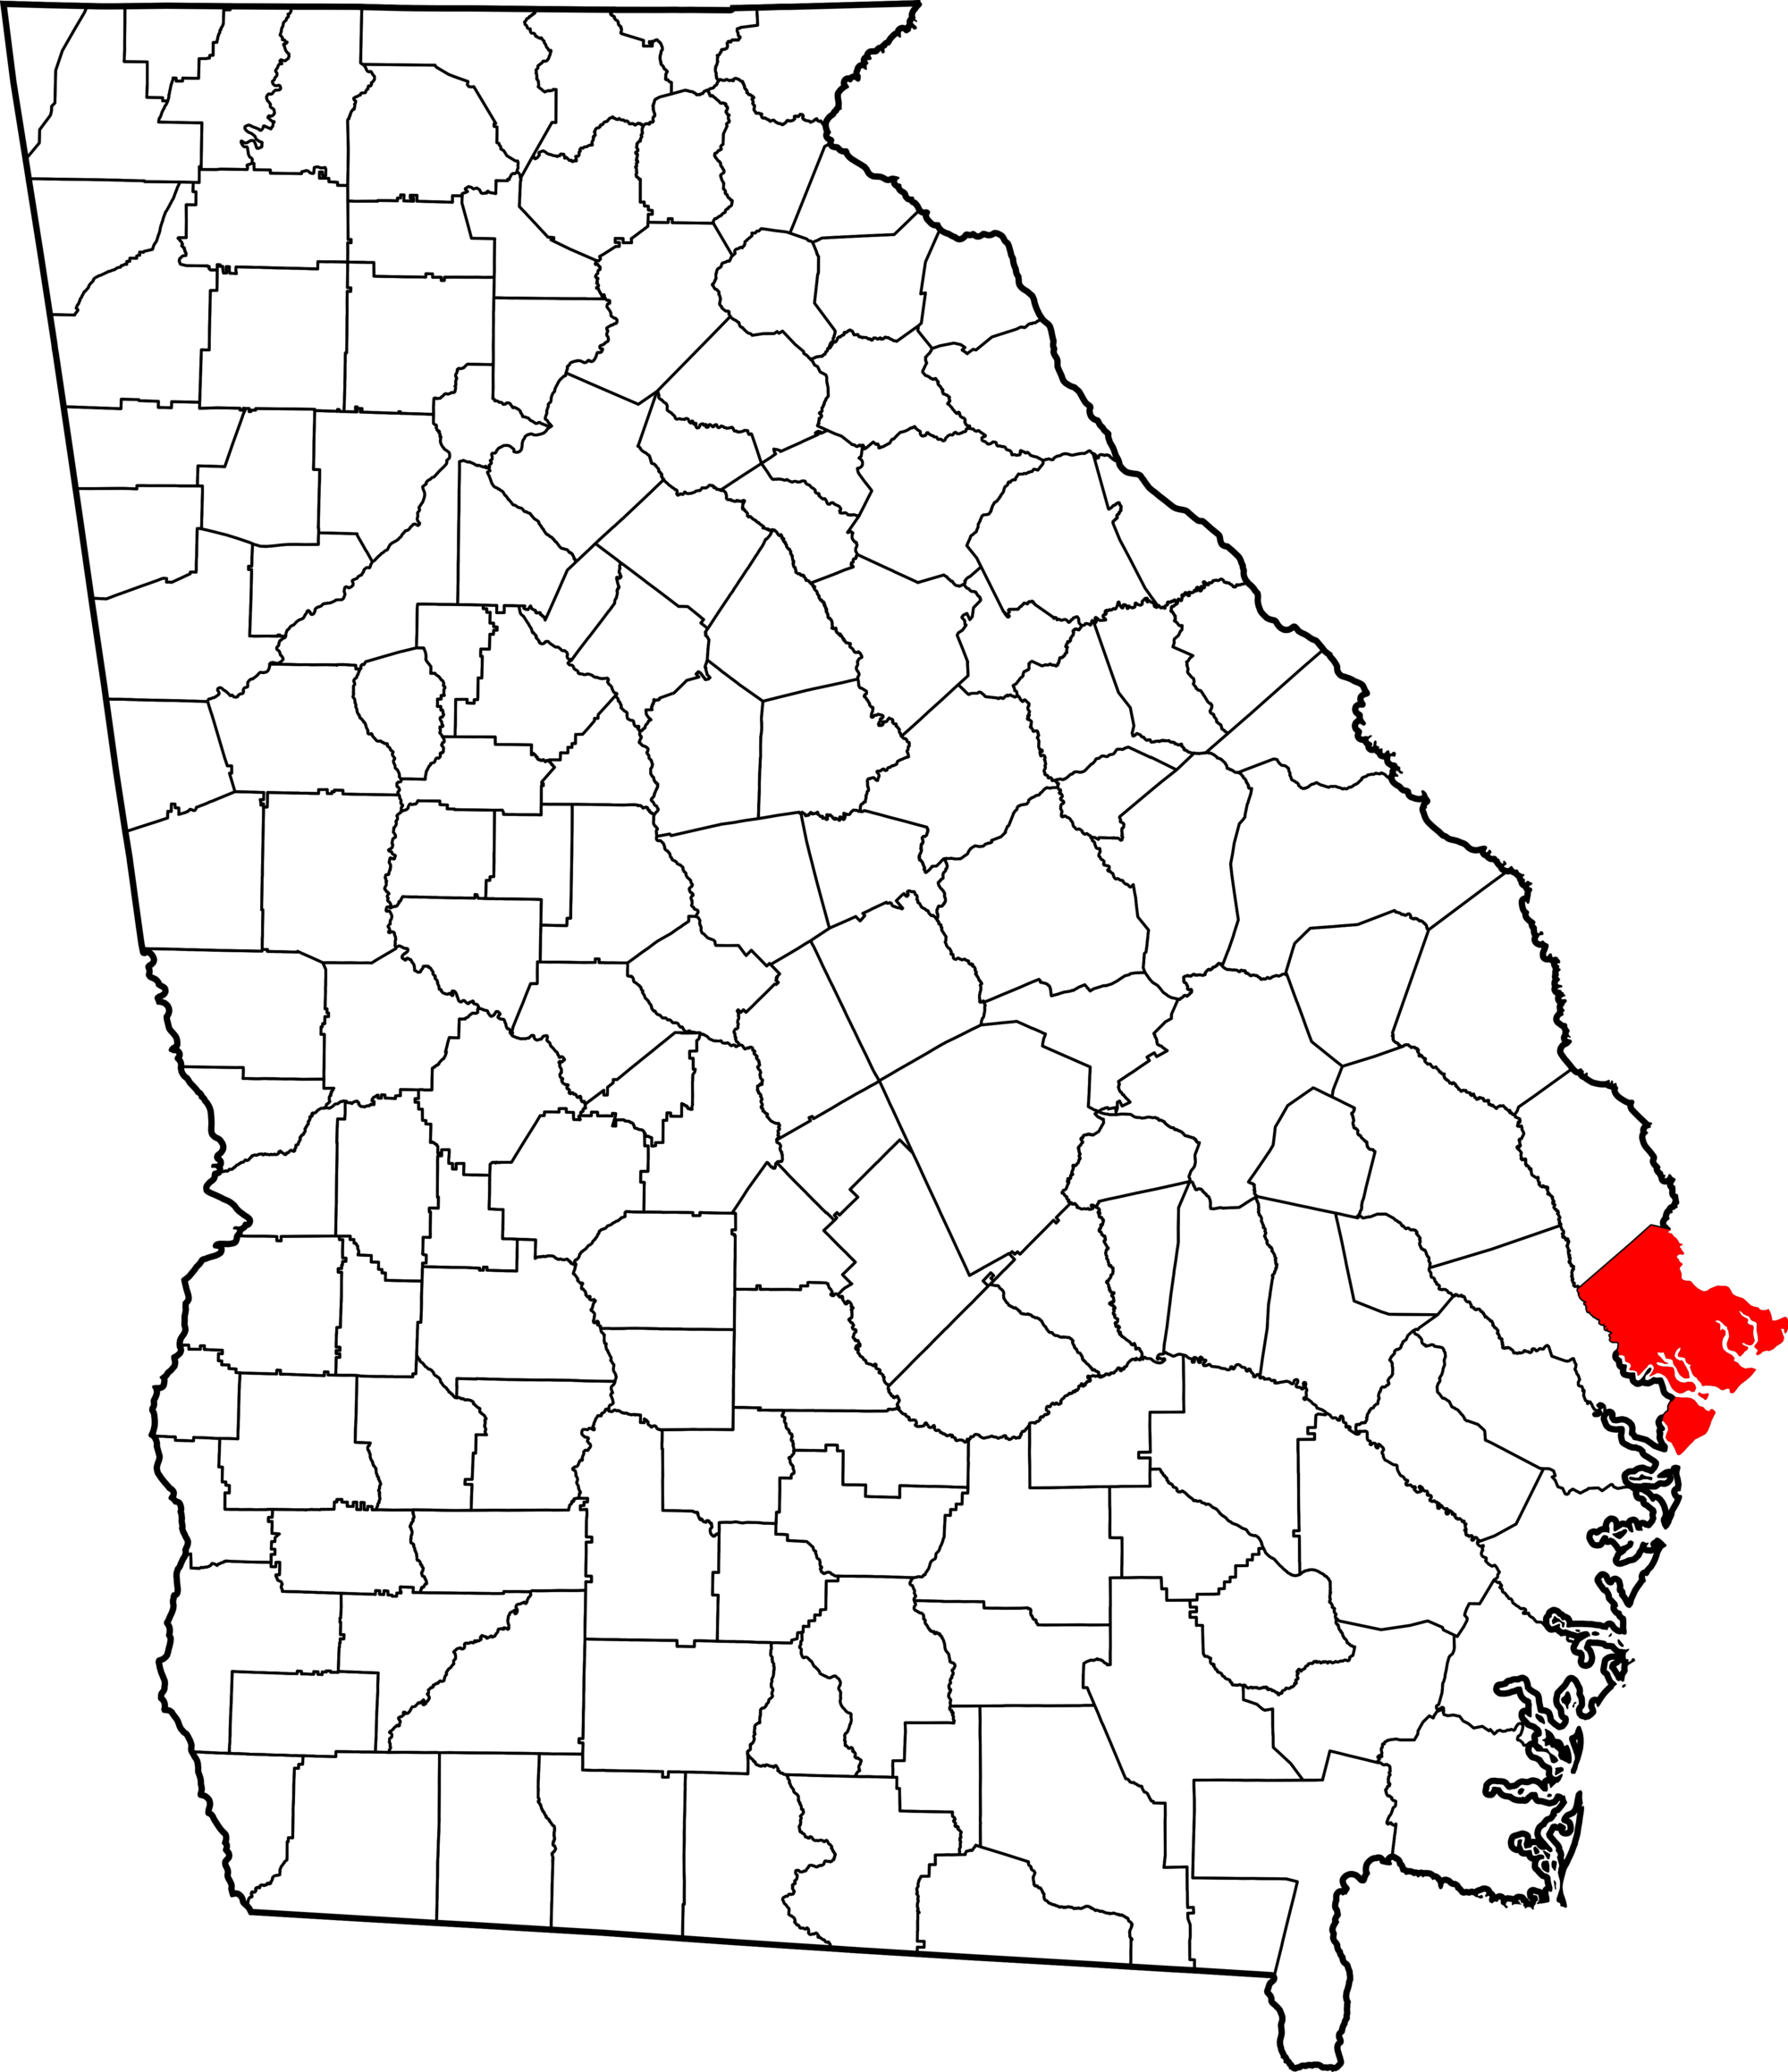
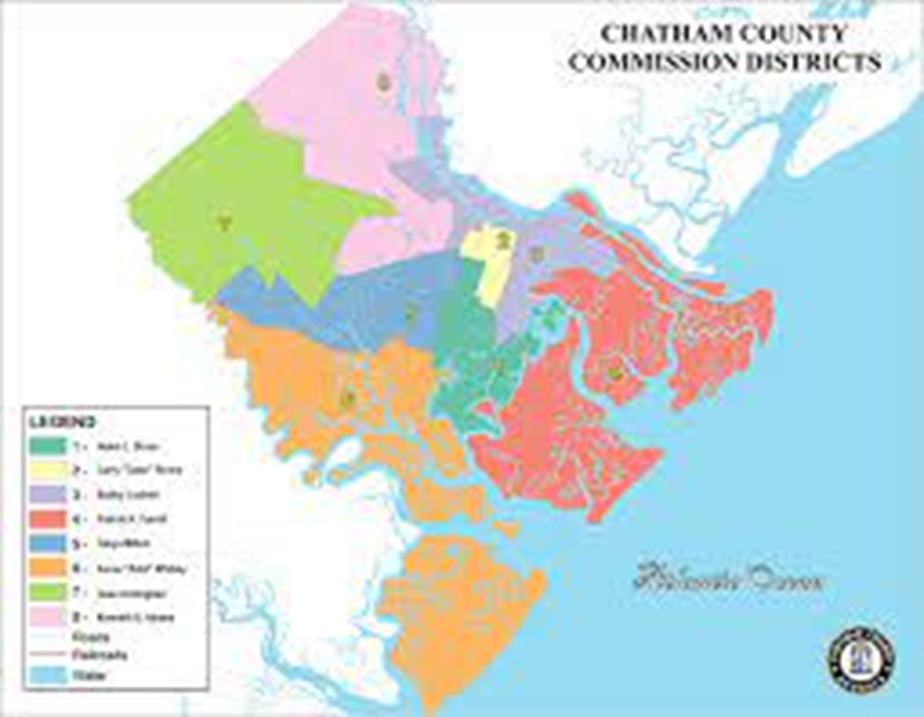
Chatham County, GA
Population 291,012
Median Household Income $63,701
People Living Below Poverty Level 14.4%

Slide 18
Chatham County: Vision & Mission
VISION: To make Chatham County, Georgia the best place to live, work, and play!
The mission of Chatham County Government is to protect and serve the public and provide essential services to improve the quality of life.

Slide 19
Chatham County: Core Values
Honesty through Integrity
Safety with Justice
Stewardship promoting Transparency
Efficiency with Effectiveness
Pride increasing Respect
Teamwork producing Achievement

Slide 20
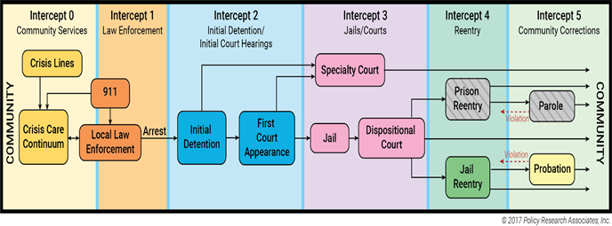
Current Chatham Initiative
Breaking the Cycle
Reduce the recidivism rate for adult offenders through an array of strategies focused on individuals with mental illness to include; (1) reducing the number of people booked in the Chatham County Detention Center, (2) shortening the length of stay at the jail, and (3) increase the percentage of individuals with connection to care.

Slide 21
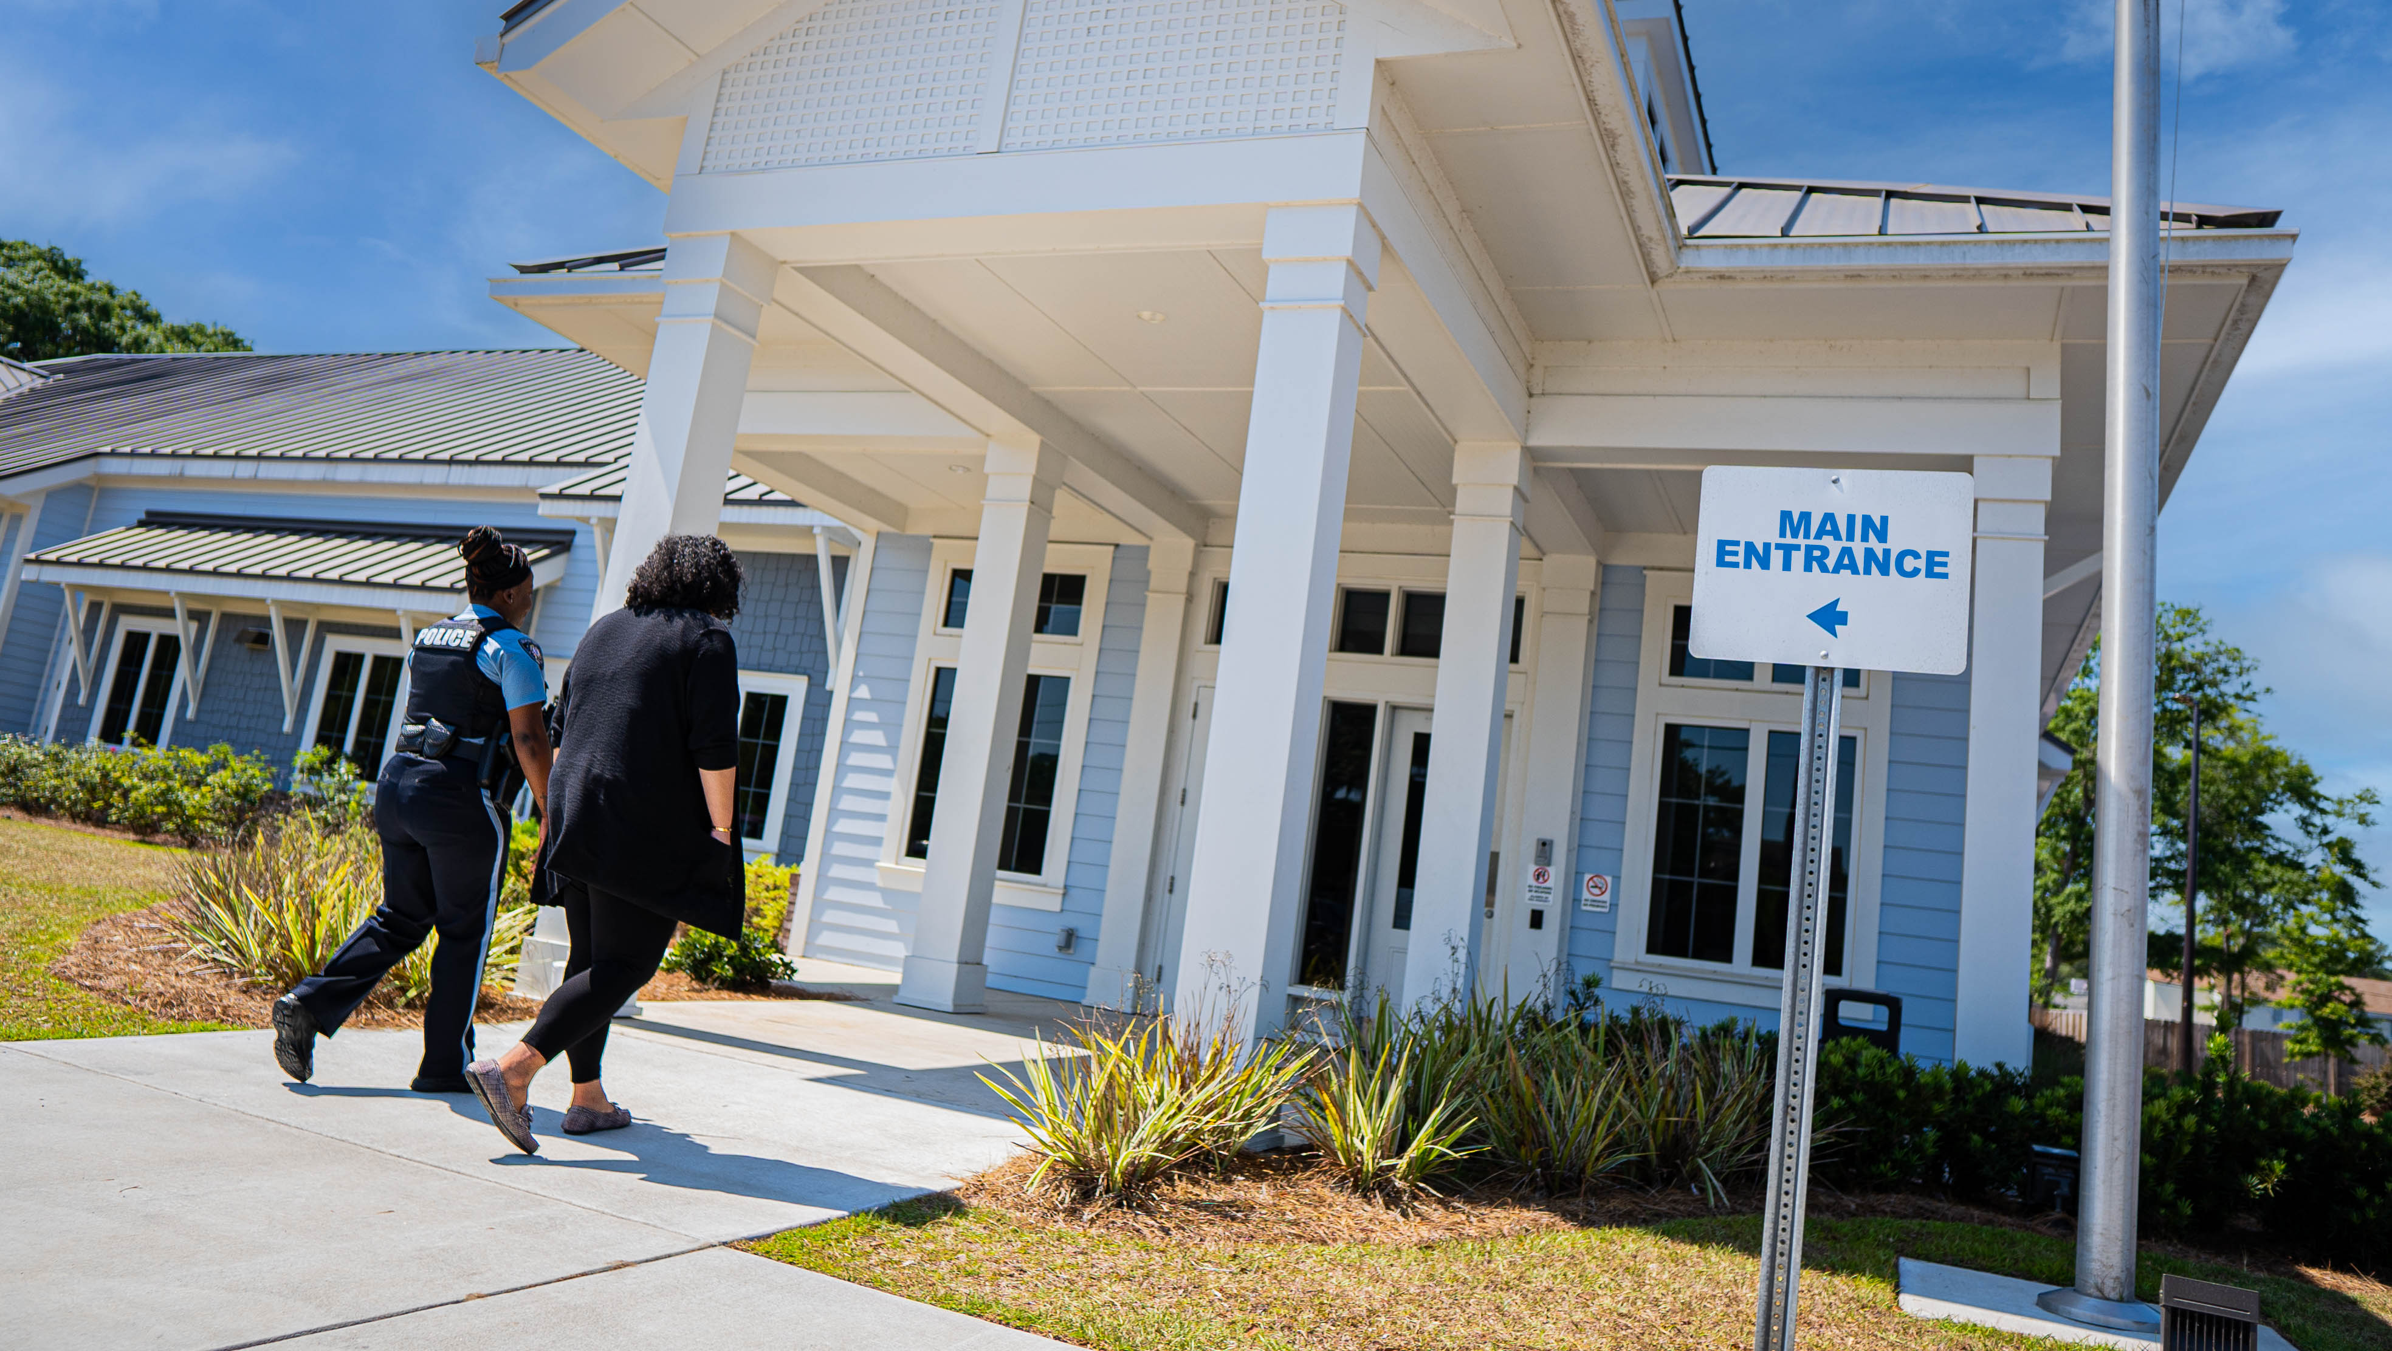
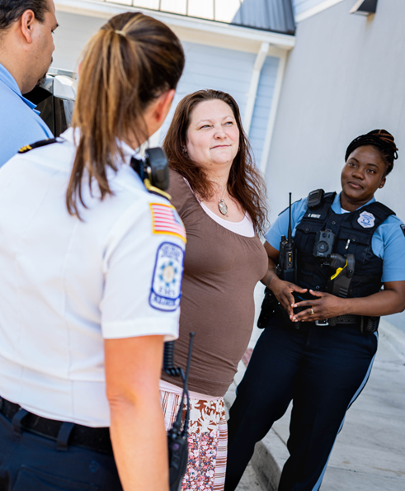
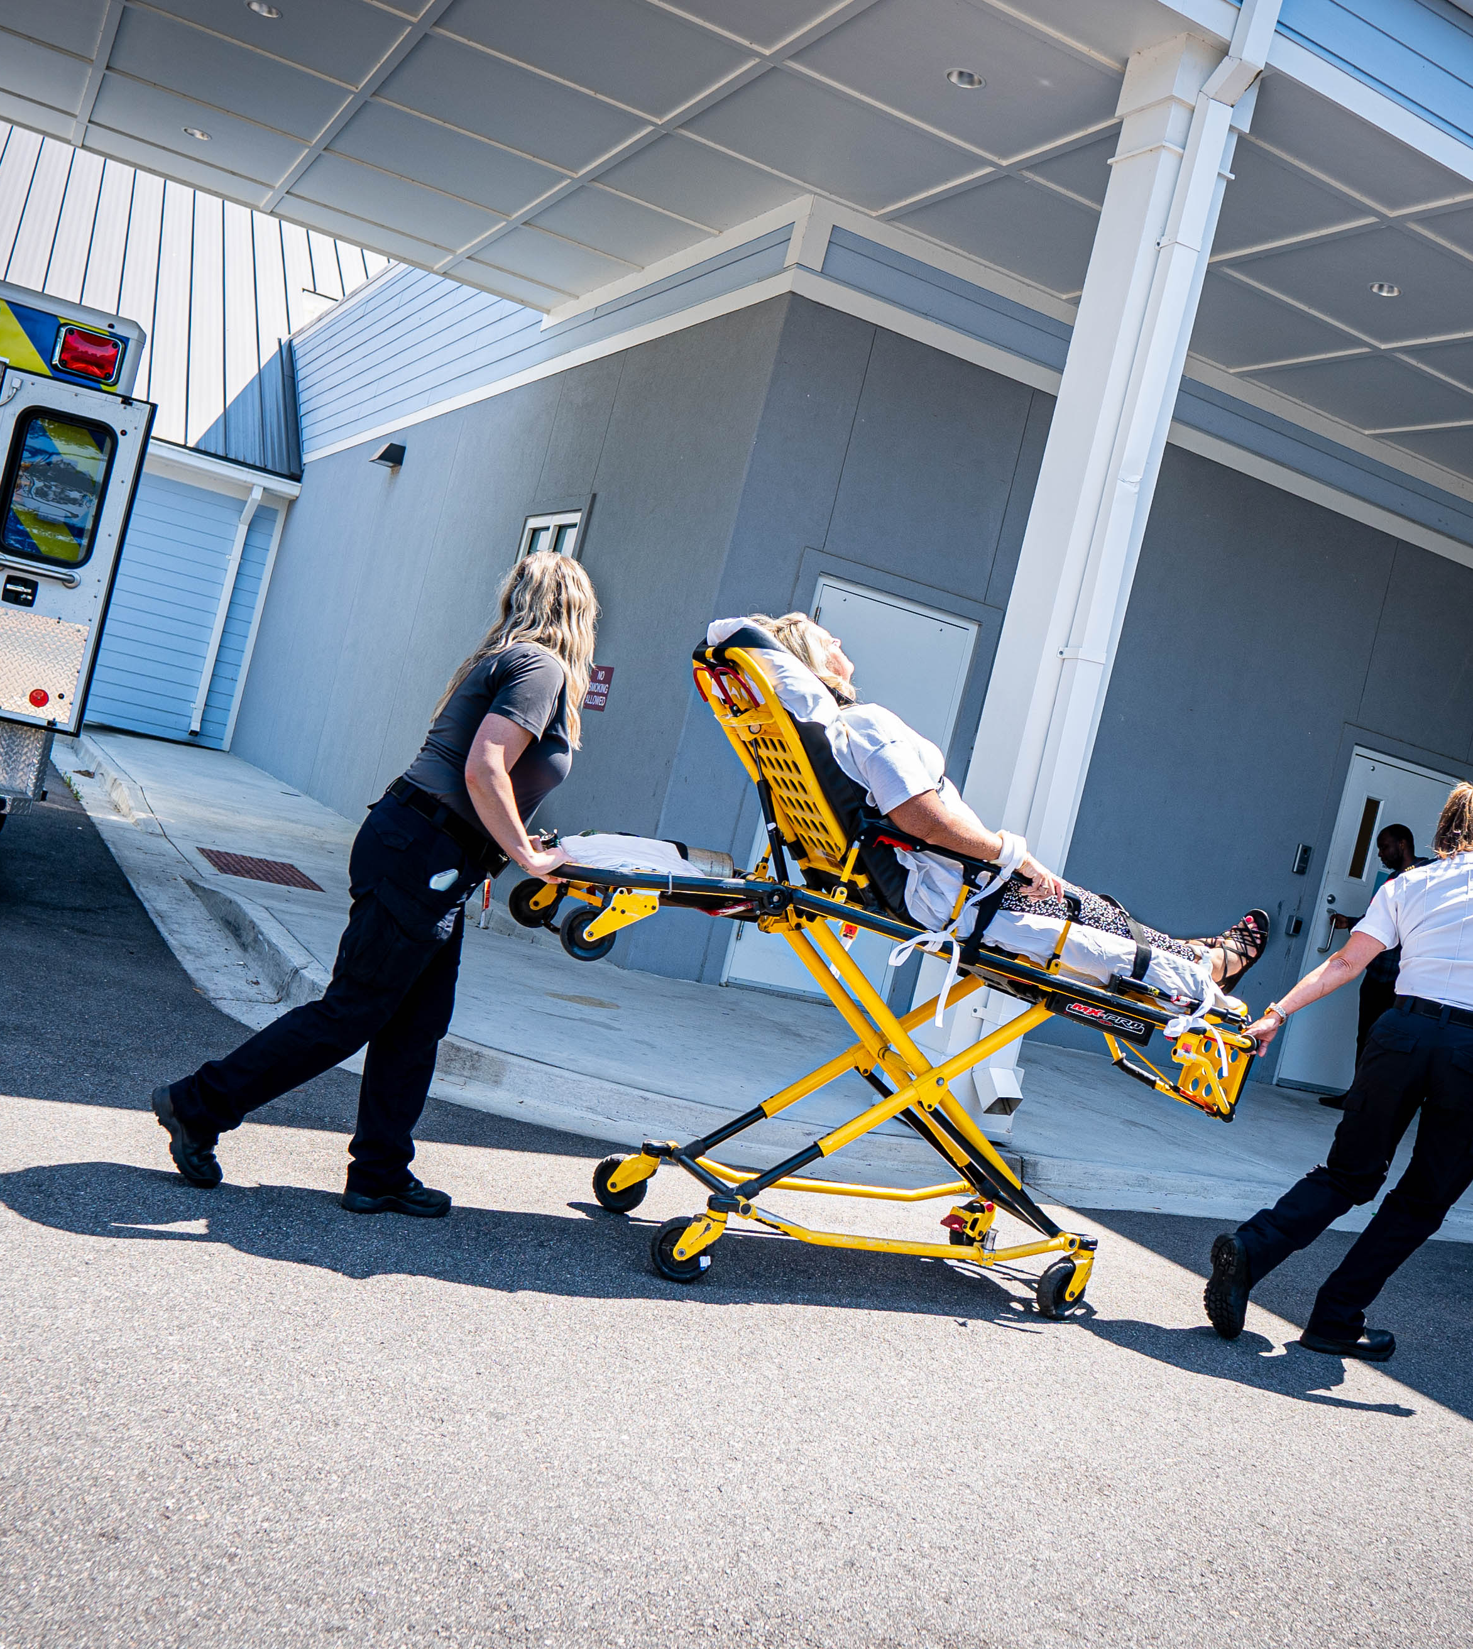
Chatham
Behavioral Health Crisis Center
Behavioral Health Co-Responder
Unit ET3 – Triage, Treat & Transport

Slide 22
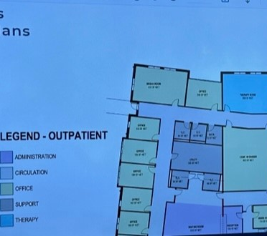
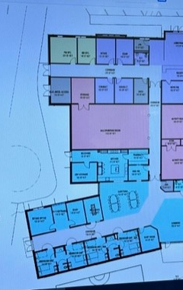
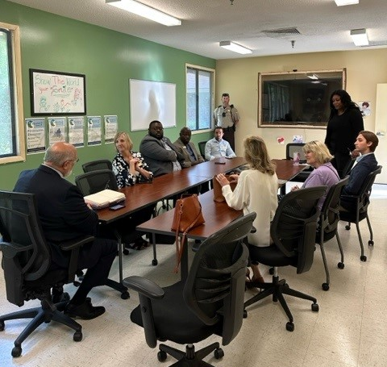
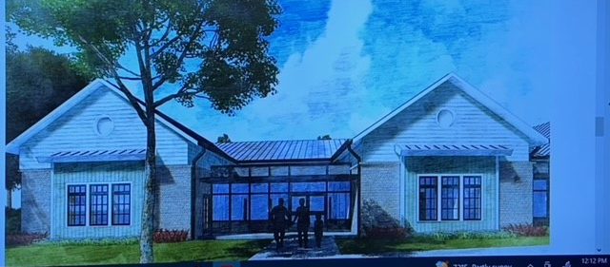

Exploring Options for Enhancements

Slide 23


Slide 24
Thank You! Contact Info…
Blaire Bryant
Legislative Director for Health
NACo
(202) 942-4246
bbryant@naco.org
Gabe Carter
Governmental Affairs Associate
ACCG
(470) 591-6622
gcarter@accg.org
Chairman Michelle Morgan
Board of Commissioners
Carroll County
(770) 830-5800
mmorgan@carrollcountyga.com
Commissioner Helen Stone
Board of Commissioners
Chatham County
(912) 656-2967
district1@chathamcounty.org
Mary Beth Brownlee
County Consulting Services Associate
ACCG
(404) 227-4976
mbbrownlee@accg.org
Mike O’Quinn
County Consulting Services Associate
ACCG
(404) 925-0764
moquinn@accg.org

