Slide 1


Information Systems Update
Spring 2012
Notes:
1

Slide 2

Web-based Upgrade Advisor
Certification Upgrade Advisor
Live this weekend!
Uses information about GaPSC approved programs to advise about “new field” upgrades
Provides advice about degrees offered by eligible institutions that support “in-field” upgrades
Notes:
Upgrade Advisor Context – verbiage

Slide 3
Upgrade Advisor
Sources of information…
For New Field Upgrade – GaPSC database of approved initial certification programs at the Master’s degree level and above
For In-field Upgrade – GaPSC database of accepted advanced degree programs, list of USG degree programs, and degrees submitted to GaPSC by institutions for possible inclusion in the Advisor. Degrees are vetted and aligned to certification fields by GaPSC Certificate Upgrade Review Committee
Notes:
Screenshot of Quick View – compare in-field and new field modes

Slide 4
Upgrade Advisor
Two Modes…
  “Logged In”
    Educator will use MyPSC account to log in
    Educator’s current certification record to provide up-to-date information
    Option to save the advice to the educator’s certification record
  “Quick View”
    Anonymous
    Good for exploring
    Best for school district HR people to use
Notes:
Upgrade Advisor Context – verbiage

Slide 5
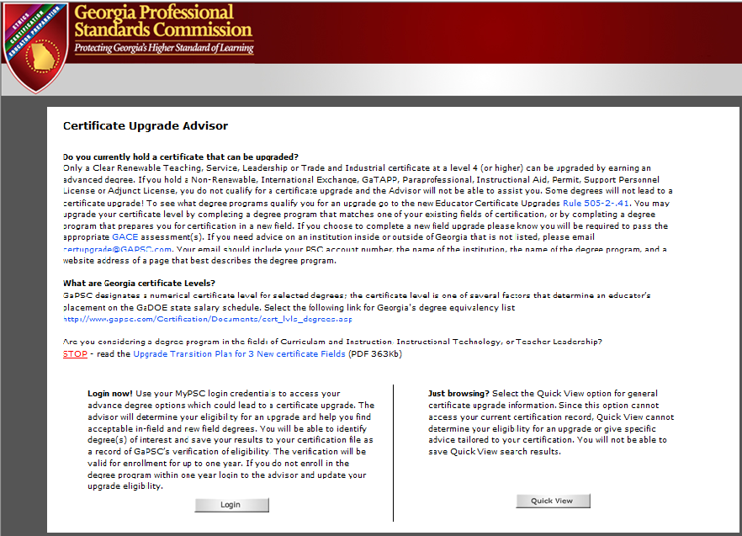

Slide 6
Upgrade Advisor – Quick View
Select between upgrade options
  In-field upgrade
  New field upgrade
Select the degree/level to be pursued
For in-field upgrade
  Select a certificate field and see institutions offering a related degree at the desired degree/level
For new field upgrade
  Select a certificate field and see institutions offering initial certification at the desired degree/level
Notes:
Screenshot of Quick View

Slide 7
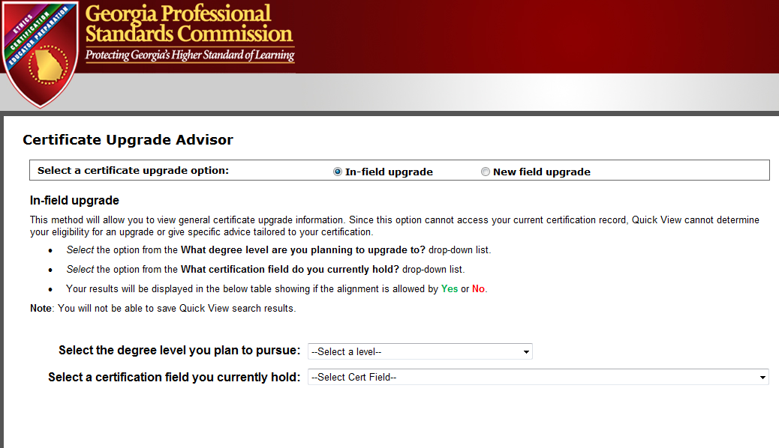

Slide 8
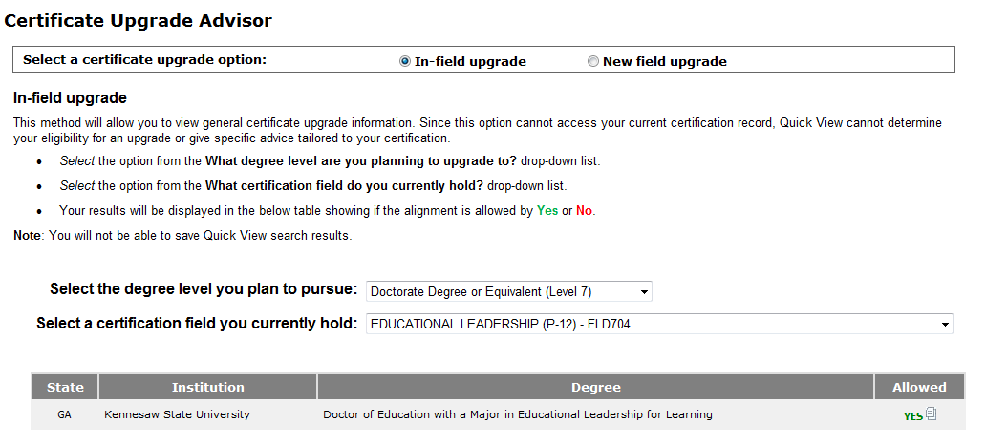

Slide 9
Upgrade Advisor – Logged In
Log in using MyPSC credentials
Select between In-field and new field upgrade options
For in-field upgrade
  Advisor displays all certificate fields & endorsements that can support an upgrade
  Select a certificate field and see institutions offering a related degree at a degree/level higher than that currently held by the educator
For new field upgrade
  Select the degree/level to be pursued
  Select a certificate field and see institutions offering initial certification at the desired degree/level
Save degrees to a list; permanently save the list to Certification record
*
Notes:
Screenshot of Quick View

Slide 10
MyPSC and Online Correspondence
Notes:
A few bullets about why, where and when

Slide 11
MyPSC and Online Correspondence
Today, on MyPSC a registered applicant/educator can…
See list of correspondence
Select a correspondence item generated after January 1, 2010, and have it sent to email address
Notes:
A few bullets about why, where and when

Slide 12
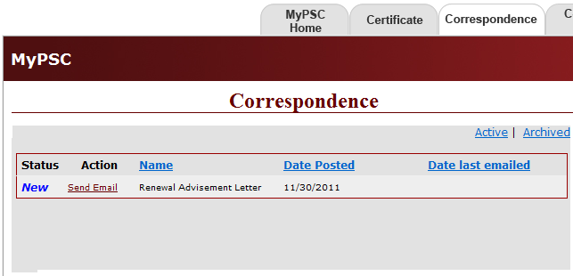
12/01/2011
Send Email

Slide 13
View Correspondence Online
Coming in mid-2012 to MyPSC…
Still see list of correspondence
Still send selected correspondence to their email address
New - view correspondence and print it
Notes:
A few bullets about why, where and when

Slide 14
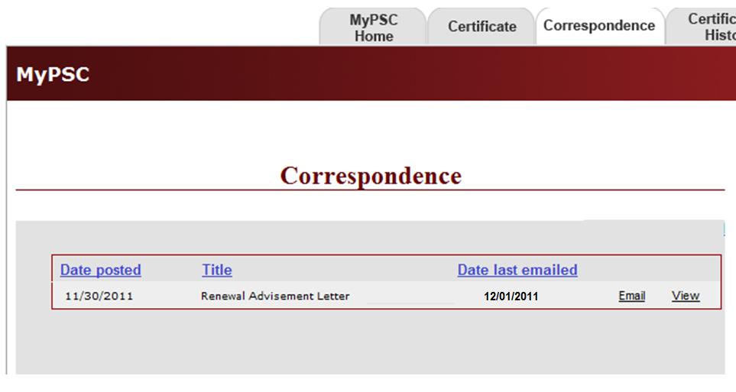
View
Online
Send Email

Slide 15
View Correspondence Online
Coming in mid-2012 to www.gapsc.org, authorized users at school systems will be able to...
View correspondence, download and/or print
Send selected correspondence to the operator’s email address of record or to any other email address
Notes:
A few bullets about why, where and when

Slide 16
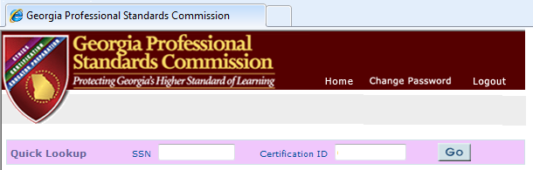
Enter SSN or Cert ID
Click “Go”

Slide 17
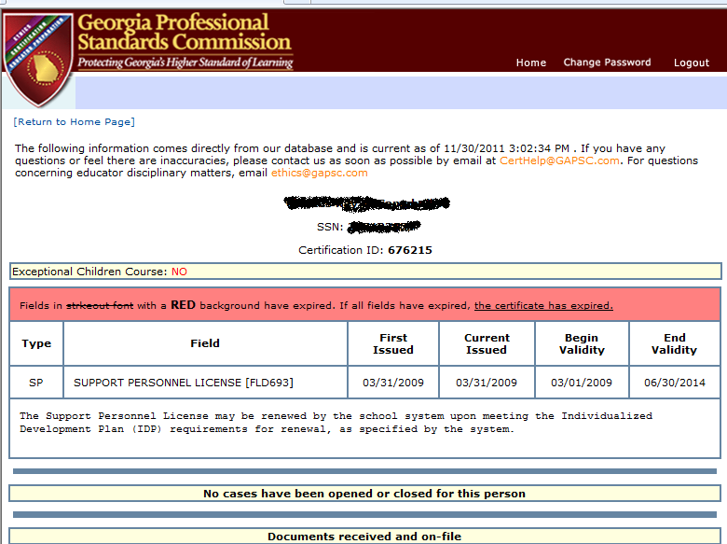

Slide 18
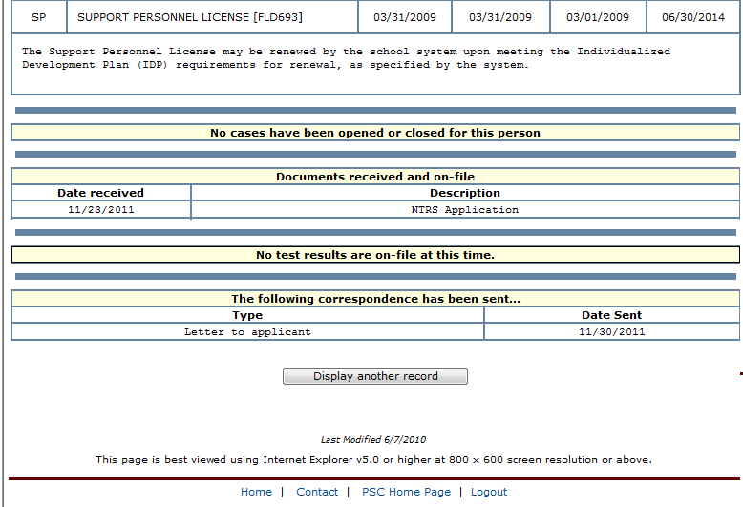

Slide 19
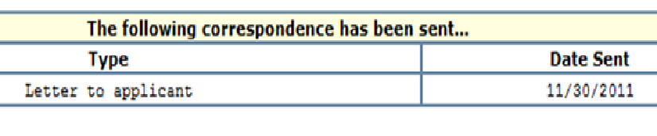

Slide 20
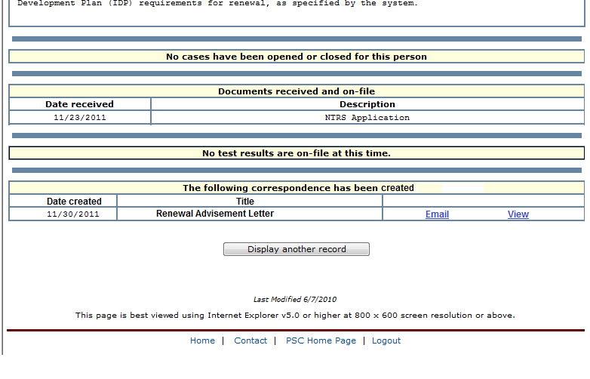

Slide 21
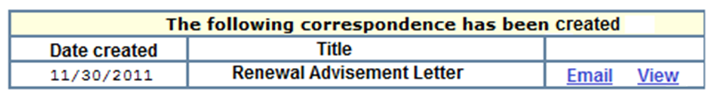
Email as PDF
View, download as PDF
and/or print

Slide 22
View Documentation Online?
Implement after “View Online Correspondence”
What types of documents?
Applications
Out of state certificates
Transcripts
Etc.
Notes:
A few bullets about why, where and when

Slide 23
HiQ2

Slide 24
HiQ2
New reports
  System Report
  Building Report
Online sign-off process (similar to AYP sign-off)
  Principals sign-off on building between May 1st and June 30th
  Superintendent signs-off on district between July 1st and August 30th.

Slide 25

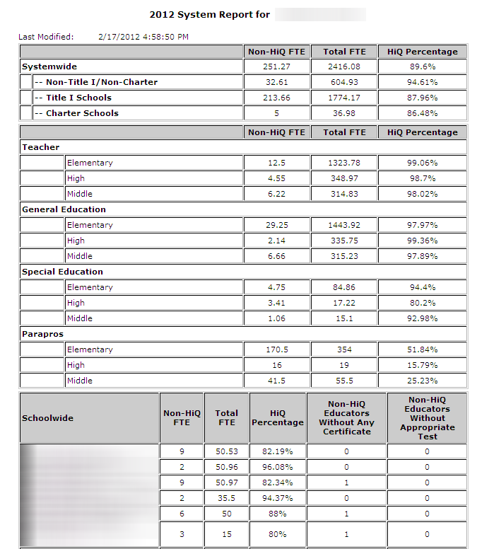
HiQ2 System Report

Slide 26
HiQ2 System Report (Cont)

Slide 27
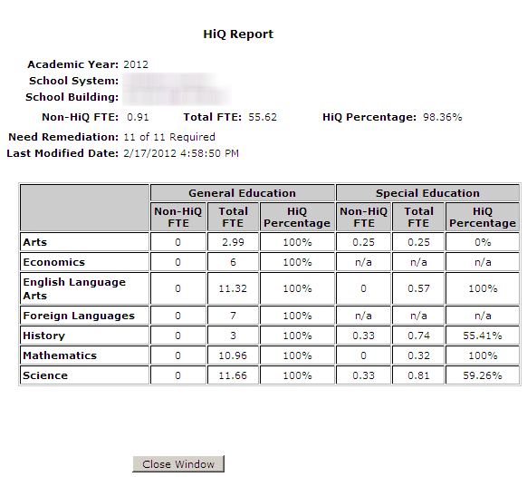
HiQ2 Building Report

Slide 28
HiQ2 Verification Process for LEAs
HR Director
Title II-A Coordinator
Send email to
certhelp@gapsc.com
Makes corrections to HiQ2
Requests a www.gapsc.org password for
Superintendent and each building principal
1/15/12 to 6/30/12
by 2/29/12
Helpful Webinars: Feb 23th (2PM – 3PM);
March 29th (10AM – 11AM);
Title II-A Coordinator
April 26th (10AM – 11AM)
Clicks “Release Data” Button
Title II-A Coordinator
Views status list of principals that
have accepted data
HiQ2
Changes can be made until 6/30/12
Activates HiQ2 link on www.gapsc.org
Emails each building principal on how to verify and accept data
HiQ2 Closes
6/30/12
Principal
Clicks “HiQ2” Button
Superintendent
Button 3
Button 2
Button 1
Logs into www.gapsc.org
Accepts data
Lists teachers, assignments, positions,
job codes, remediations
Links to Building level data
Views data
Accepts data
7/10/12 to 8/30/12

Slide 29
RT3 and GaPSC Technology

Slide 30
RT3 and GaPSC Technology
Opportunity to significantly update…
Educator Credentialing System
Educator Preparation Information System
GaPSC is a participant in the Statewide Longitudinal Data System funded through RT3

Slide 31
RT3 Impact on Data Systems & Scope of Work
Educator Credentialing
More data will be collected
More complex rules = more need for human intervention?
Better automation to maintain good turn-around time
Educator Preparation Information System
More data will be collected
Better data collection method to minimize burden on program providers
Better reporting will be needed to utilize the data effectively

Slide 32

RT3 Initiative – GA AWARDS
Not GaDOE’s SLDS that integrates into your SIS
This is a research database for use by Georgia’s Educational Agencies

Slide 33

WHAT ARE YOUR QUESTIONS ?
Notes:
33
The GAPSC, in collaboration with DOE, is responsible for the implementation of NCLB particularly the “Highly Qualified” teacher program
We utilize data from many sources, our Certification records, the tri-annual CPI reports and the Student Records
Assist schools in ensuring that all students, including the poor and minority students have access and equitable opportunities to highly qualified instruction.
These measures include teachers’ instructional experience, ability to meet the diverse learning needs, and classroom size

Slide 34
Presenter’s Email Addresses
Kelly.Henson@gapsc.com
David.Hill@gapsc.com
K.Young@gapsc.com
Chuck.McCampbell@gapsc.com
Notes:
34
The GAPSC, in collaboration with DOE, is responsible for the implementation of NCLB particularly the “Highly Qualified” teacher program
We utilize data from many sources, our Certification records, the tri-annual CPI reports and the Student Records
Assist schools in ensuring that all students, including the poor and minority students have access and equitable opportunities to highly qualified instruction.
These measures include teachers’ instructional experience, ability to meet the diverse learning needs, and classroom size

