Slide 1
Developing Academic Vocabulary
Presenter: Nancy Updegraff Ph.D.

Slide 2
Developing Tasks, Activities, and Assessments
Level Four
Level Three
Level Two
Level One
Knowledge Utilization
Decision Making, Problem Solving, Experimenting, Investigating
Analysis
Matching, Classifying, Analyzing Errors, Generalizing, Specifying
Comprehension
Integrating, Symbolizing
Retrieval
Recognizing, Recalling, Executing
Notes:
CORE SLIDE
Segmentation: Laggards
Activity Type: Critical input
Facilitation Notes
Ask participants if they have ever had a straight A student perform poorly on standardized tests. How can a student do so well in class, but not on assessments that require them to utilize knowledge in new situations?
Introduce the triangle that represents Marzano’s Taxonomy. Participants will typically want to compare it with Blooms and Webb’s taxonomy's. Spend a few minutes comparing similarities and differences.
Ask--why would we introduce Marzanos Taxonomy when discussing Scale? Encourage administrators to keep levels of difficulty in mind when reviewing the assessment tasks their teachers use. Assessment tasks will be an integral part of any scale development process. Tasks assigned to levels three and four on the scale will reflect tasks at levels three and four on the taxonomy.
As an administrator this may be a place that you could focus professional development if you find trends in assessment tasks that represent lower levels of difficulty.
For teachers, the discussion should center around the need to have assignments at Levels three and four and to write assessments at Levels 3 and
This is meant to be an awareness level activity. Don’t get stuck, the concept is advanced, but important to be aware of when thinking about learning goals and their rigor.
Associated Materials:
Academic Notebook Page: 14—a sample

Slide 3
Teaching New Vocabulary
Teaching and learning of vocabulary needs to be intentional.
Follow a 6 step model
Model Marzano, Pickering
Research based
Structured and strategic

Slide 4
Academic Vocabulary
Have students track progress and levels of understanding.
Track number of words learned
Preview new material to select academic vocabulary to be taught.
Review
Have a academic word wall

Slide 5
STEP 1
Provide a description, explanation, or example of the new term

Slide 6
Step 1
Introduce a direct experience
Tell a story, read a paragraph
Use video or computer images
As group to research and present information
Describe your own mental picture
Create pictures with the class of the term

Slide 7
Step 1
Not a definition of the term
Does not ask students to look up definitions of the term
General overview of the term
We don’t expect students to become proficient in Step 1

Slide 8
Step 1 – ELL, Special Ed
Provide an example and a nonlingustic representation
Relate to something students know: “like a, but….”
Provide more initial practice
Make sure everyone pronounces and says a definition out loud

Slide 9
Thematic Webbing
Build a semantic web at the beginning of a unit around a word from the theme and add to it during the course of the theme
Semantic Web

Slide 10
Venn Diagram
One of the best ways to learn a word is by what it is and what it is not
Use double bubble Venn diagrams to assist students in building additional vocabulary

Slide 11
Compare and Contrast
A ______ and _____ are similar because they both_______.
A ______ and a _____ are different because they_______.

Slide 12
Compare and Contrast
The sun and the moon are similar because they both
Are in outer space
Influence our lives
Shine

Slide 13
Compare and Contrast
The sun and the moon are different because
The sun is farther away in miles from the earth
The sun is made of gases
The moon is made of rock and dust
The sun controls temperatures
The moon controls ocean tides

Slide 14
Classifying
Give students a group of pictures and ask them to classify in as many ways as possible.
Give students a group of terms from their chapter and ask them to classify. Have them add other words in each category

Slide 15
Analogies
Bone is to skeleton as word is to_______
Bone is to _______ as word is to________.
_______ is to skeleton as word is to _______.
_______ is to _______ as word is to sentence.
Be sure to have students explain their answers!

Slide 16
Questions, Questions
100, 200, 300, 400, 500
Rain, snow, sleet
Sun, soil, water, carbon dioxide

Slide 17
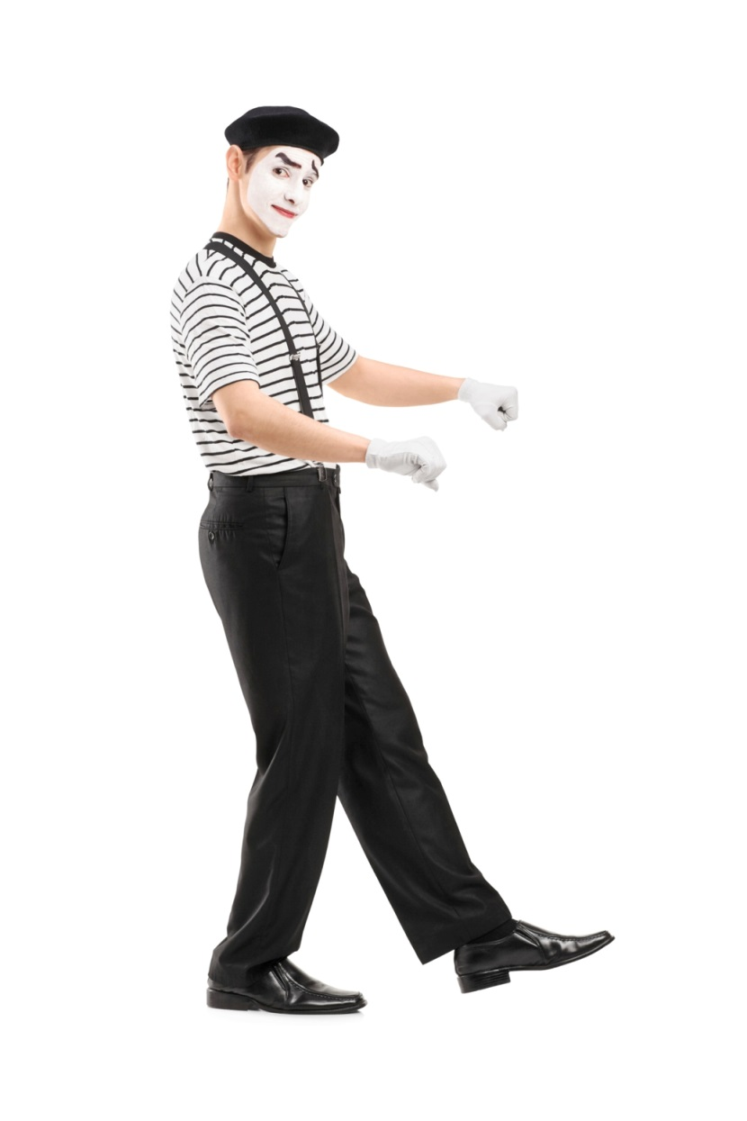
Charades/Pictionary
Have students act out the word through bodily movements.
Have students draw sketch the word and add to it until students have discovered meaning.
Discuss students after the game, why they decided to portray or draw the word the way they did. Ask students also to describe what was confusing or lead them to select the wrong word.

Slide 18
Pyramid
One partner has the word and tries to get the other one to say the word in as few tries as possible.
Have someone keep track of all the incorrect guesses and discuss reasons for that guess.

Slide 19
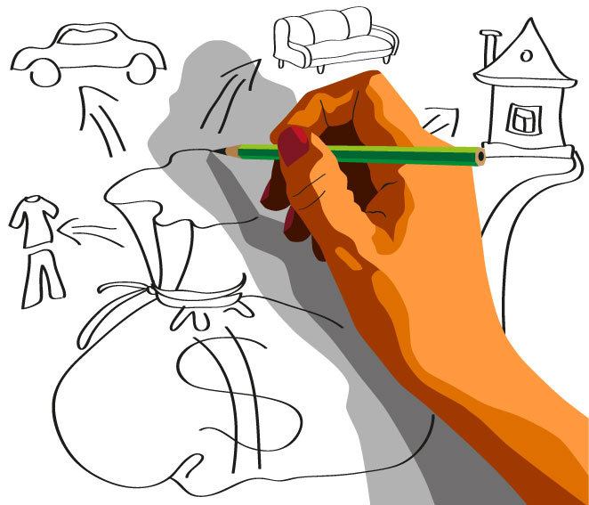
Reverse Pictionary
Groups of students try to get a student to draw the term through giving precise directions.
One student is the designated artist. The other students must give instructions one at a time, adding or correcting until picture is complete.
It is like a…… bigger than a……
“Property”

Slide 20
Mile a Minute
Give students a word
They must speak about the word for one minute.
Before students begin to speak tell them to take 30 seconds and think before beginning to speak for a minute.

Slide 21
Mile a Minute Minus
Have students speak for a minute and give them something they may not mention.
Example: speak about “rain” and do not mention “umbrellas’
Speak about “trees” and do not mention “forests.”

Slide 22
Step 2
Ask students to restate the description, explanation, or example in their own words.

Slide 23
Step 2
Students to not copy teacher’s words or examples
You may need to:
Provide additional descriptions or examples
Allow students to discuss in partners or small groups

Slide 24
Vocabulary Notebook
Record of students’ work
Recording of vocabulary terms is updated and refined with new knowledge
Should be used in all content subjects such as math, science, social studies
Students will make their own glossary for notebook and add to it with new terms

Slide 25
Academic Vocabulary Notebook
Term: ______________________________________
Description:_________________________________ __________________________________________________________________________________________
Picture or sketch:

Slide 26
Step 3
Construct a picture, symbol or graphic representing the term or phrase

Slide 27
Step 3
Model- show examples of student sketches
Sketch
Work in pairs or small group
Not works of art, not coloring activity
Use internet for images of the term
Picture is a “jog” for the memory

Slide 28
Step 3
Students can draw symbols
Graphics are acceptable
Some students may pantomime or dramatize term.

Slide 29
Step 4
Engage students periodically in activities that help them add to their knowledge of the terms in their notebooks.

Slide 30
Step 4
Learning academic vocabulary is NOT a “one and done” experience.
Reexamine vocabulary to deepen understanding.
Terms in academic notebook should be developed and expanded.

Slide 31
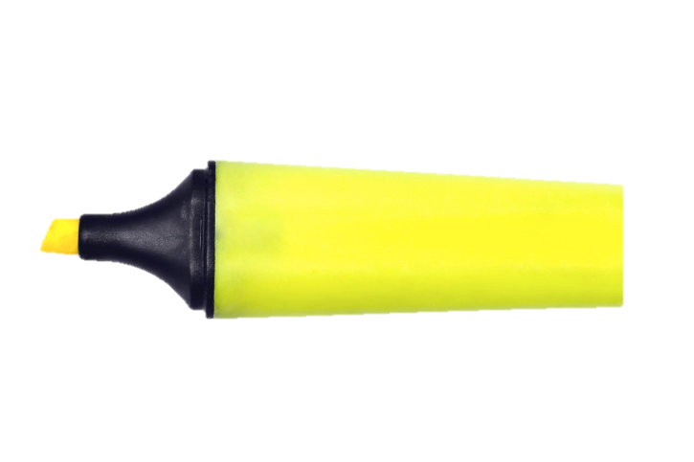
Step 4
Highlight to help remember
Add synonyms or antonyms
Use a graphic organizer to expand the meaning
Develop a list of related words

Slide 32
Step 5
Periodically ask students to discuss the terms with one another.

Slide 33
Step 5
Think-Pair-Share
Remember students need time to think
Compare
Contrast
Explain
Identify
Describe pictures

Slide 34
Step 6
Involve students in academic games that allow them to play with terms

Slide 35
Puzzle/ Picture Vocabulary
Using a puzzle or picture – picture from the text or reference material is good source
Give students a category and have them find things that fit in the category.
Example:
Find things that are organic, inorganic
Create an equation using objects in the picture
Create an analogy using things in the picture

Slide 36
Memory
Good for centers, elementary
2 cards, one with word, one with definition
Students turn cards over and mix
Students try to make matches with words and definitions.

Slide 37
Antonyms, antonyms
Activities for centers
Using cards write vocabulary words on each card.
Word opposites can be written on other cards and game played like memory
Students can create their own opposites

Slide 38
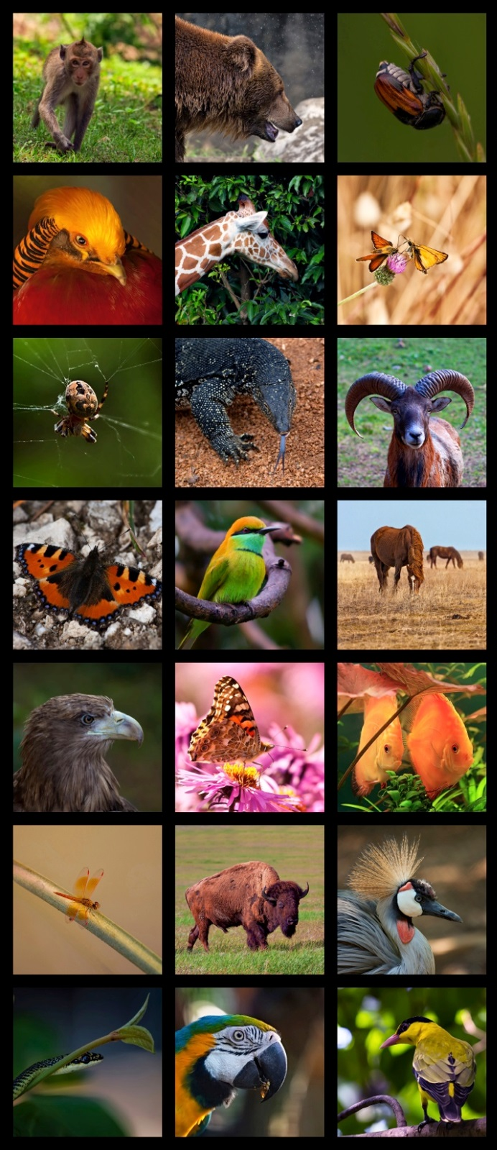
Questions, Questions
Using pictures or text pictures give students a list of vocabulary words.
Students must create questions in which the answer contains a vocabulary word.
Example: Where is the invertebrate in the picture?

Slide 39
Magic Letter- Magic Word
After reading a selection in a text or chapter in a content book students are given a clue and a word which begins with a “magic” letter to discover the “magic” word.
Examples: Math
Letter S “ What is the word for 7-4?”
Letter I “ A triangle with at least two sides of equal length is an________________”
Letter T “ A statement that can be proven true based on statements previously proven true is a______”

Slide 40
Which Doesn’t Belong
Divide the class into teams
You can set up sets of terms and phrases ahead of time or have teams develop their own sets of terms and phrases
Students must determine which word or phrase does not belong.
Example: avalanche, landslide, tsunami, drought

Slide 41
Touch and Go
Place vocabulary words on cards and stick around the door frame.
As students are about to exit use questions to get them to say the vocabulary word and then “touch” and “go” line up.
Example: find a word that is the opposite of, give me a sentence for ______;Use _____ in a sentence.

Slide 42
Questions?

Slide 43
Thank you!
LearningSciences.com

