Slide 2
The Georgia School Superintendents Association would like to thank these sponsors for their support of the 2015 Spring Bootstrap Conference.

Slide 3
Gold Sponsors

Slide 6
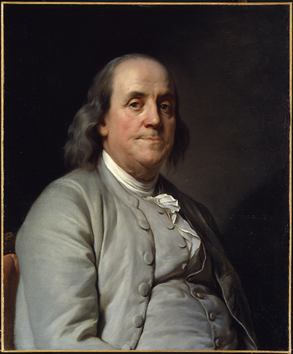
“Be slow in choosing a friend, slower in changing.”
“A man wrapped up in himself makes a very small bundle.”
Benjamin Franklin

Slide 7
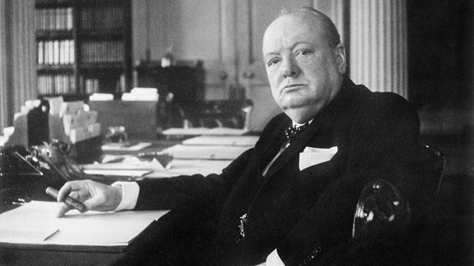
“Success is not final, failure is not fatal: it is the courage to continue that counts.”
“Courage is the finest of human qualities because it guarantees all the others.”
Winston Churchill

Slide 10
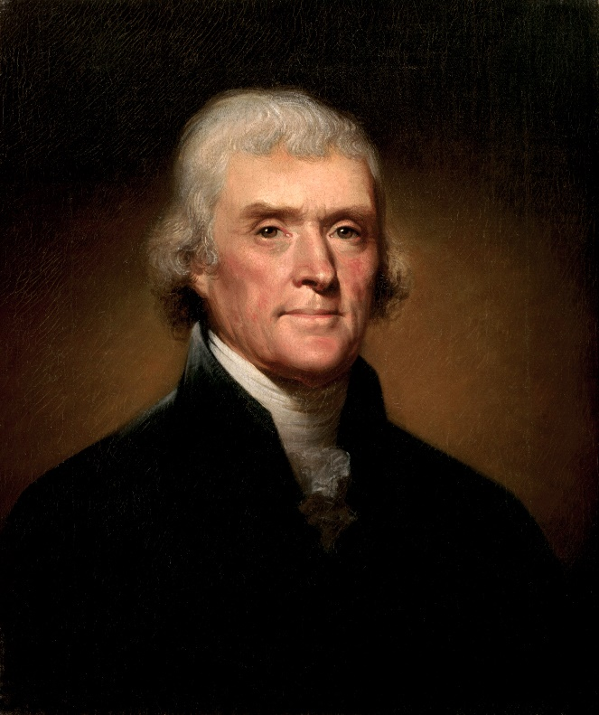
“An honest man can feel no pleasure in exercise of power over his fellow citizens.”
Thomas Jefferson

Slide 11
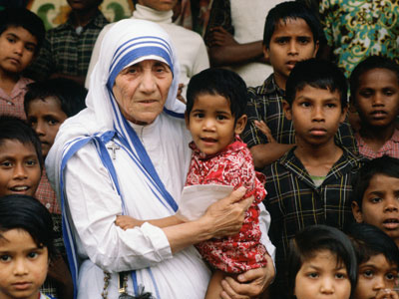
“Do not wait for leaders: do it alone, person to person.”
Mother Teresa

Slide 14
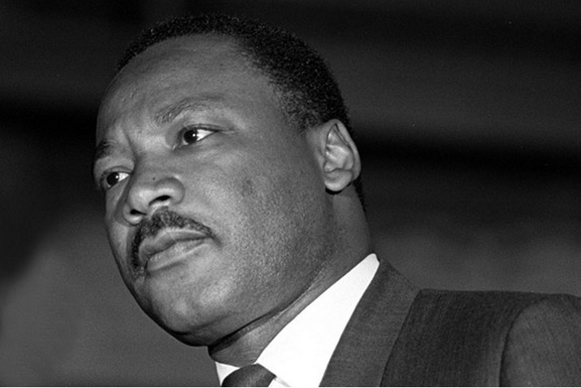
“The ultimate measure of a man is not where he stands in moments of comfort and convenience, but where he stands at time of challenge and controversy.”
Martin Luther King, Jr.

Slide 15
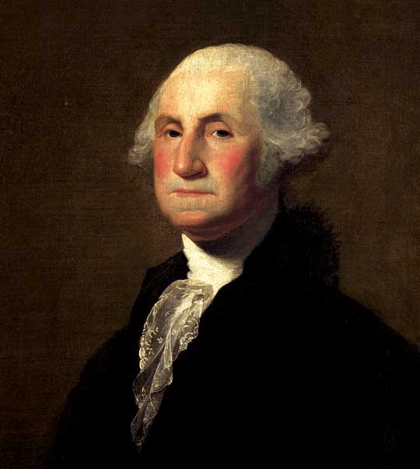
“It is better to offer no excuse than a bad one.”
“Few men have virtue to withstand the highest bidder.”
George Washington

Slide 18
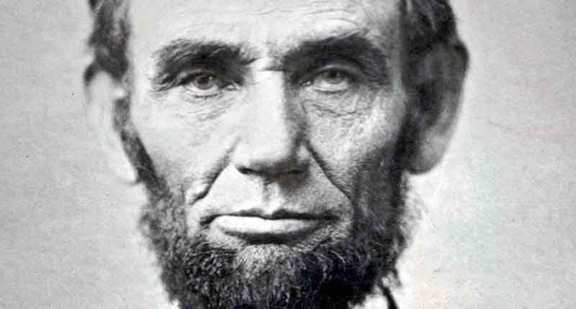
“I do not think much of a man who is not wiser today than he was yesterday.”
Abraham Lincoln

Slide 19
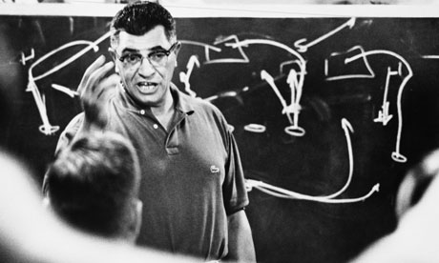
“Once you have established the goal you want and the price you’re willing to pay, you can ignore the minor hurts, the opponent’s pressure and the temporary failures.”
Vince Lombardi

Slide 23
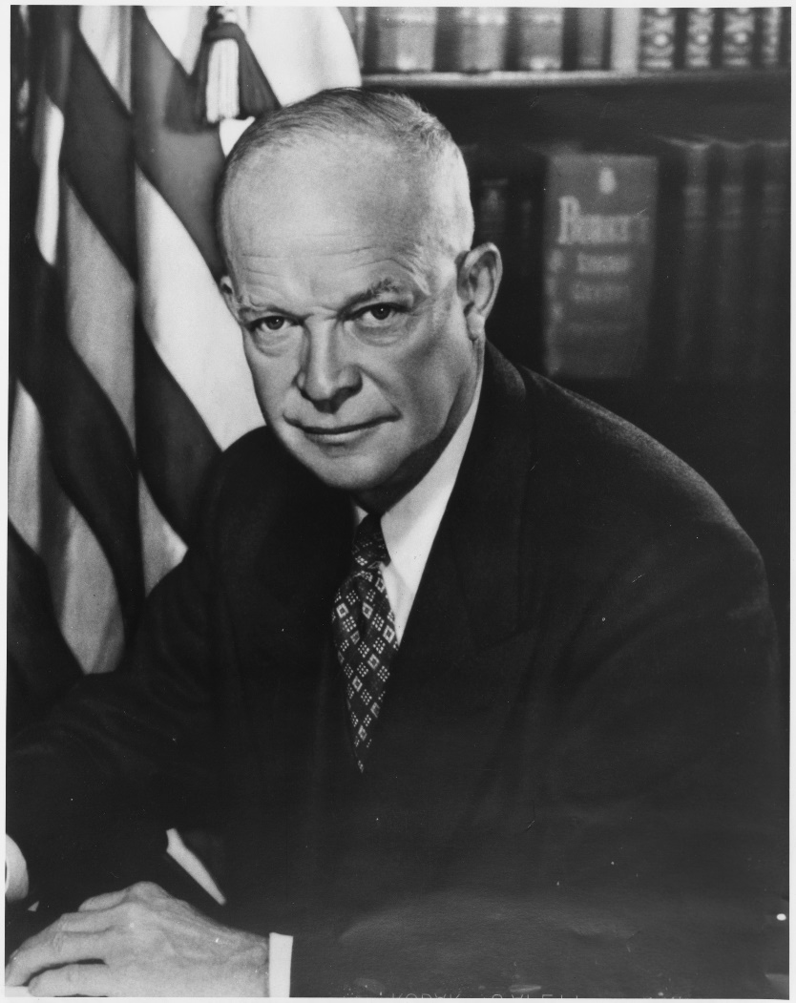
“The supreme quality for leadership is unquestionable integrity. Without it, no real success is possible.”
“You don’t lead by hitting people over the head-that’s assault, not leadership.”
“A sense of humor is part of the art of leadership, of getting along with people, of getting things done.”
Dwight Eisenhower

Slide 24
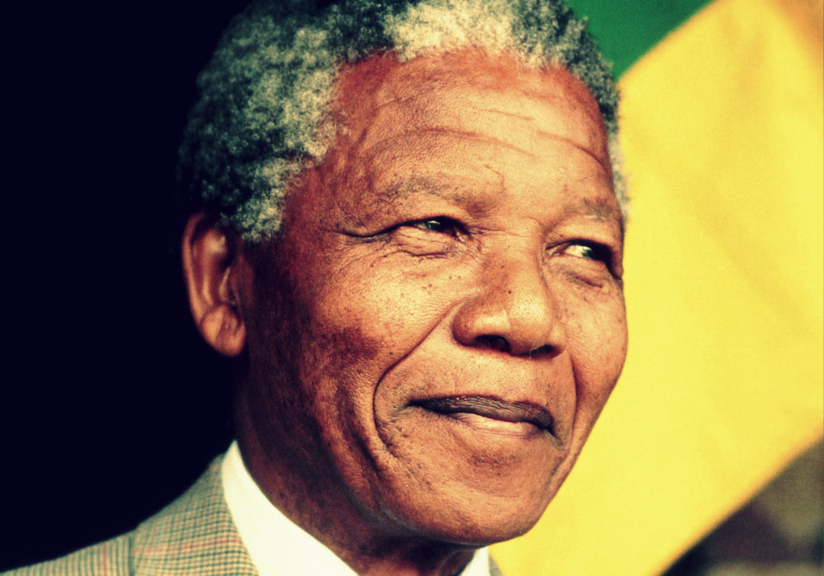
“Education is the most powerful weapon which you can use to change the world.”
“A good head and a good heart are always a formidable combination.”
“There can be no keener revelation of a society’s soul than the way in which it treats its children.”
Nelson Mandela

Slide 25
Silver Sponsors

Slide 29
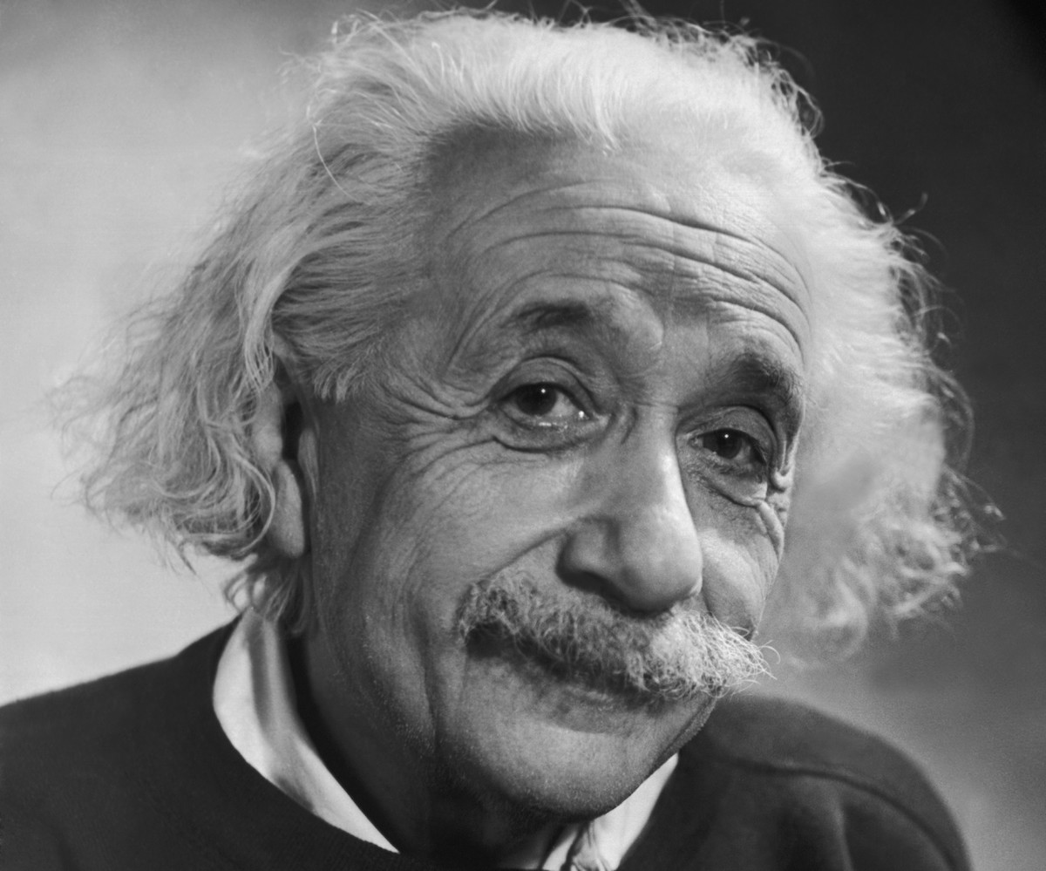
“Truth is what stands the test of experience.”
“Try not to become a man of success but rather to become a man of value.”
“The only real valuable thing is intuition.”
Albert Einstein

Slide 30
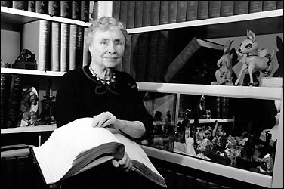
“Character cannot be developed in ease and quiet. Only through experiences of trial and suffering can the soul be strengthened, vision cleared, ambition inspired and success achieved.”
“To be blind, but worse is to have eyes and not see.”
Helen Keller

Slide 33
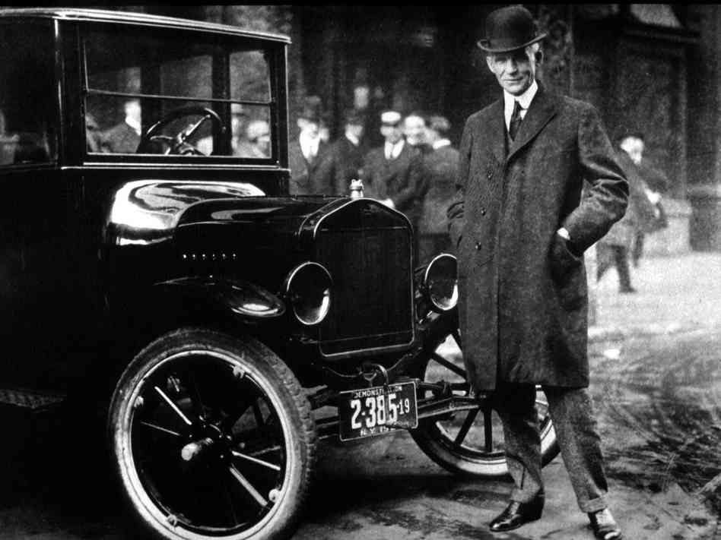
“Chop your own wood and it will warm you twice.”
Henry Ford

Slide 34
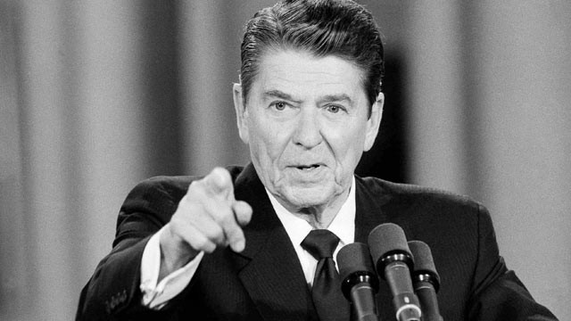
“They say the world has become too complex for simple answers. They are wrong.”
Ronald Regan

Slide 37
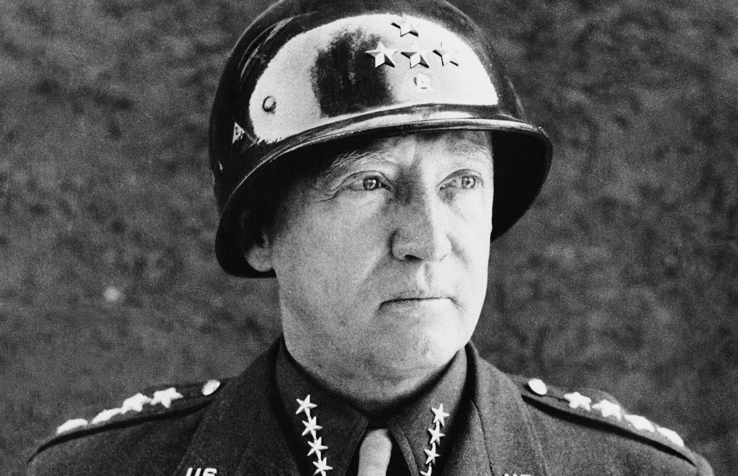
“Success is how high you bounce when you hit bottom.”
“Courage is fear holding on a minute longer.”
George S. Patton

Slide 38
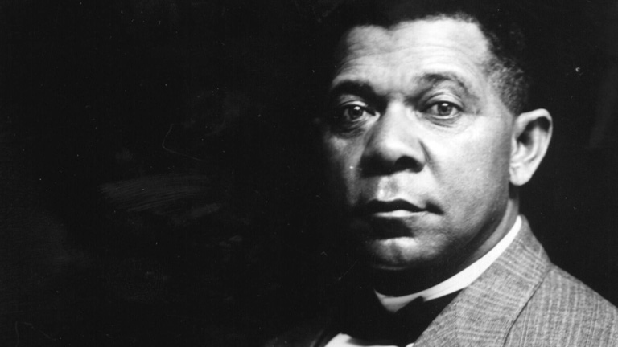
“Character is power.”
“Character, not circumstances, makes the man.”
Booker T. Washington

Slide 41
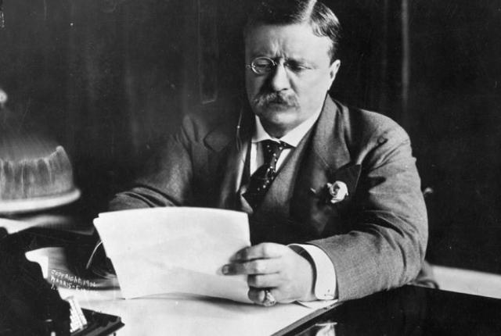
“In a moment of decision the best thing you can do is the right thing. The worst thing you can do is nothing.”
“People ask the difference between a leader and a boss. The leader leads, and the boss drives.”
Theodore Roosevelt

Slide 42
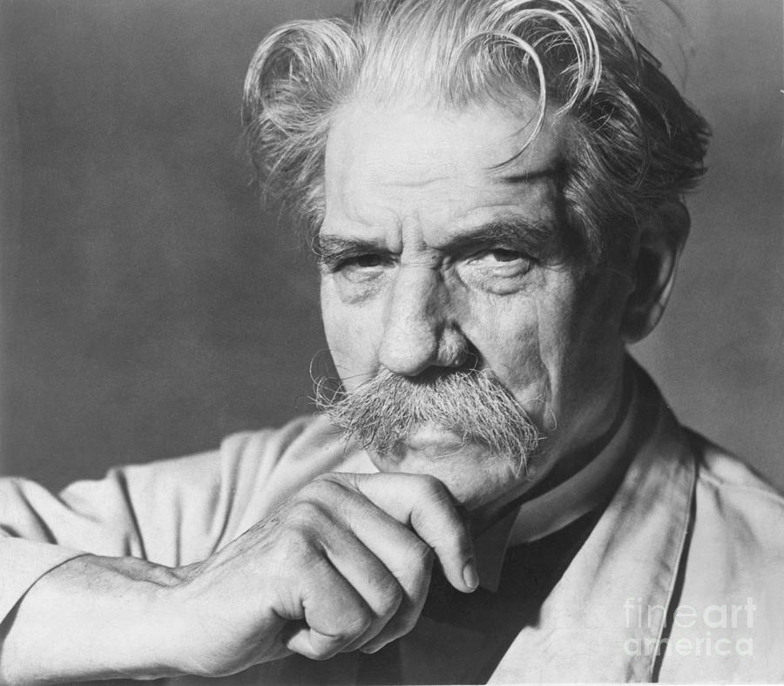
“Example is leadership”
Albert Schweitzer

Slide 45
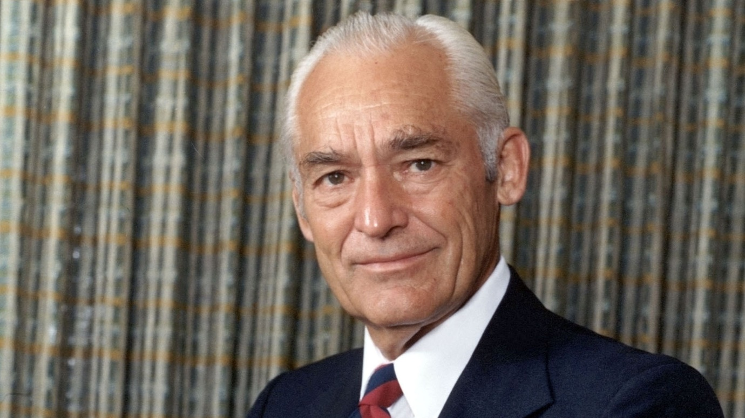
“Outstanding leaders go out of their way to boost the self-esteem of their personnel. If people believe in themselves, it’s amazing what they can accomplish”
Sam Walton

Slide 46
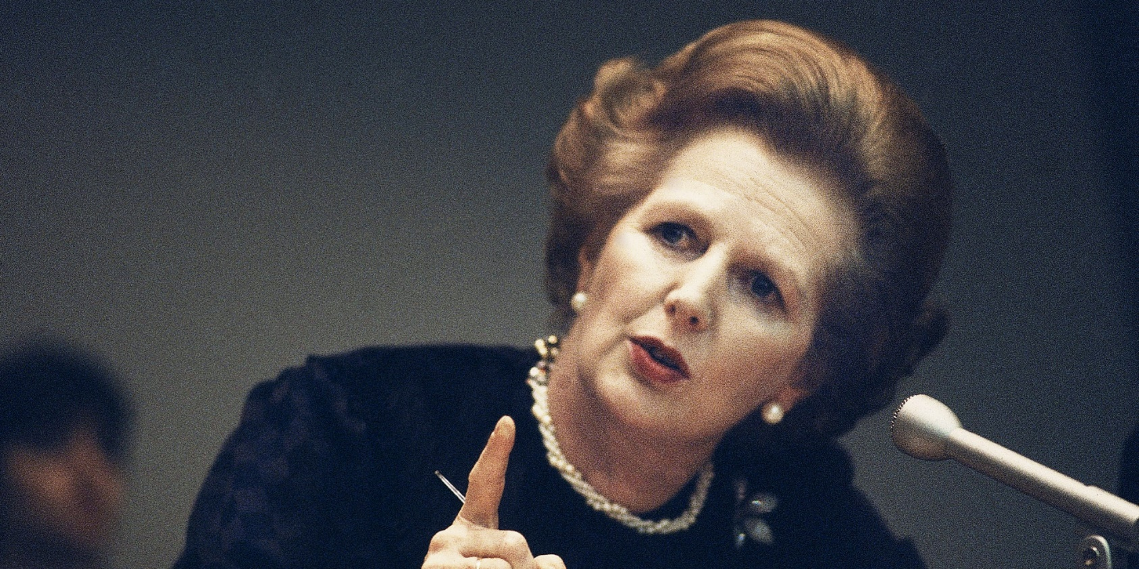
“You may have to fight a battle more than once to win it.”
Margaret Thatcher

Slide 47
Bronze Sponsors

Slide 48
McGowan Governmental Underwriters (MGU)
Lew Marshall
lewmarshall@mguins.com

Slide 51
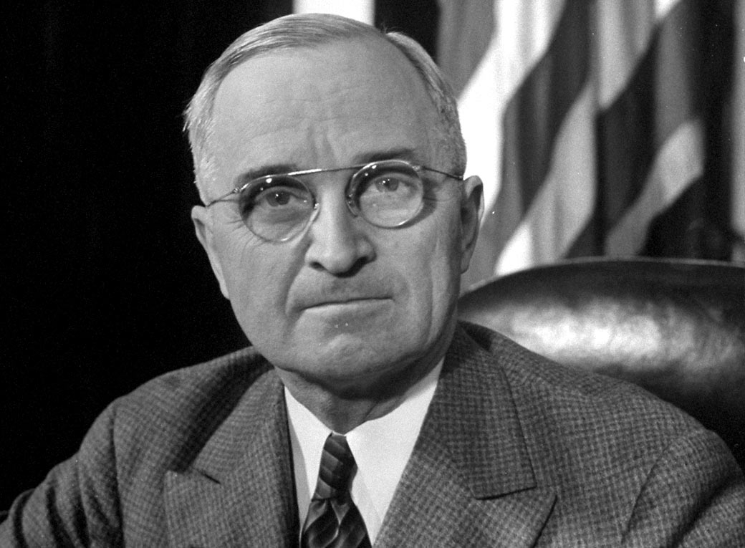
“If you can’t convince them, confuse them.”
“It’s amazing what you can accomplish if you do not care who gets the credit.”
Harry S. Truman

Slide 52
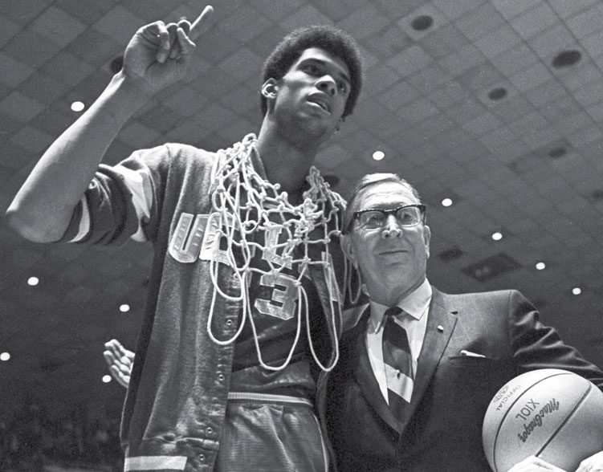
“Failure is not fatal, but failure to change might be.”
John Wooden

Slide 55
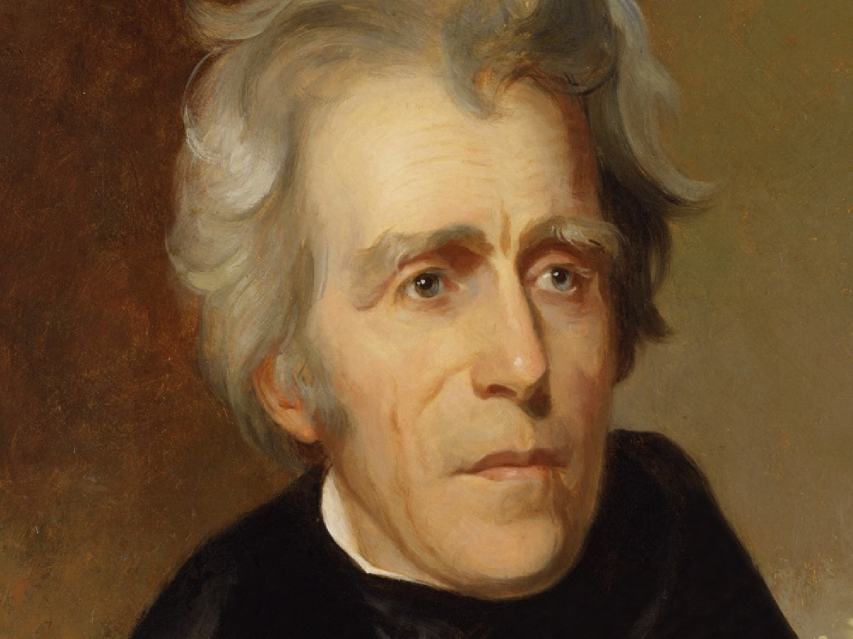
“One man with courage makes a majority.”
Andrew Jackson

Slide 56
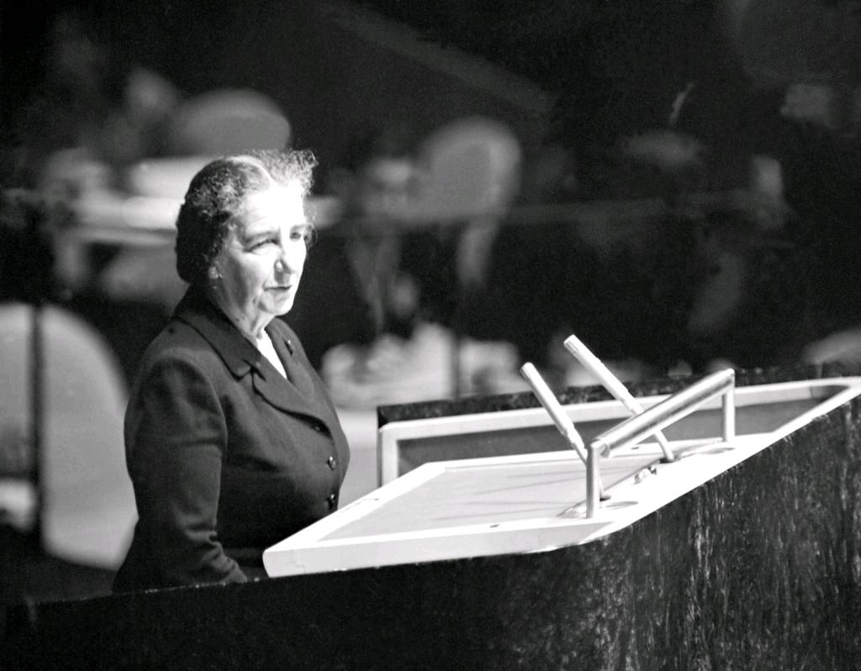
“You’ll never find a better sparring partner than adversity.”
Golda Meir

Slide 65
