Slide 1
Essential Question: How do I analyze a polynomial function?
Daily Questions:
1). How are turning points related to the degree of a polynomial?
2)How do you determine domain & range of polynomial function?
3)How is the range affected by relative or absolute extrema?
4)What is synthetic substitution?

Slide 2
Extrema…..
Let’s Summarize the Task
f(x) = a_{n}x^{n} + a_{n-1}x^{n-1} + …..+ a₀
The function of f has at most n – 1 relative extrema (relative minimums or maximums)
Extrema are turns in the graph

Slide 3
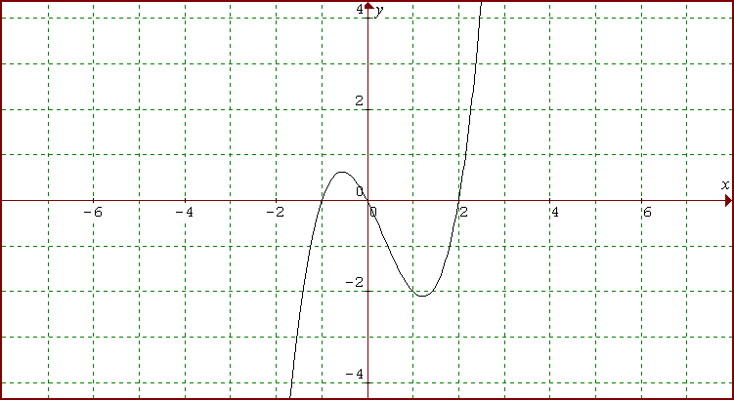
What is the least possible degree of this function?
What is the domain and range of this function?

Slide 4
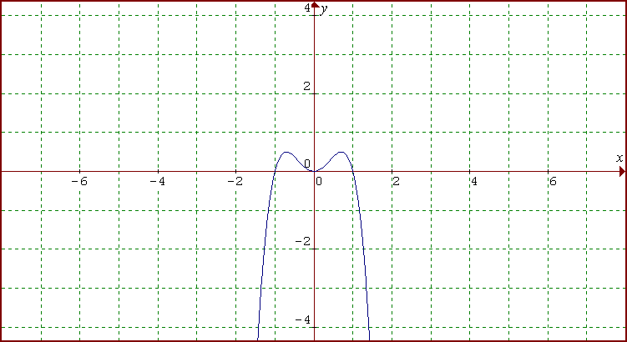
What is the least possible degree of this function?
What are the max’s & min’s of this function?
(-.7071 , .5) (0 , 0) (.7071 , .5)
What is the domain and range of this function? Let’s find the relative extrema….

Slide 5

Using Synthetic Substitution
One way to evaluate polynomial functions is to use direct substitution. Another way to evaluate a polynomial is to use synthetic substitution.
Use synthetic division to evaluate
f (x) = 2 x ⁴ + −8 x ² + 5 x − 7 when x = 3.

Slide 6
You have done direct substitution …let’s look at synthetic substitution.

Slide 7
Using Synthetic Substitution
SOLUTION
2 x ⁴ + 0 x ³ + (–8 x ²) + 5 x + (–7)
Polynomial in
standard form
Polynomial in standard form
3 •
2 0 –8 5 –7
3
Coefficients
Coefficients
6
18
30
105
So f(3) =98
x-value
2
6
10
35
98
The value of f (3) is the last number you write,
In the bottom right-hand corner.

Slide 8
Tell me everything you know about the equation…
Even degree of at least 4, positive leading coefficient, Domain is all Real’s, Range is
Notes:
Page 261 #53

Slide 9
Tell me everything you know about the equation…
Odd degree of at least 5, positive leading coefficient, Domain is all Real’s, Range is all Real’s
Notes:
Page 261 #54

Slide 10
Tell me everything you know about the equation…
Even degree of at least 4, negative leading coefficient, Domain is all Real’s, Range is
Notes:
-x^4+3x^2+4

